Slide 1
Investigating Social Vulnerability Analysis and Implementation in Emergency Management
Ashley E. Morris
Baltimore County Homeland Security and Emergency Management
Virginia Emergency Management Symposium 2021

Slide 2
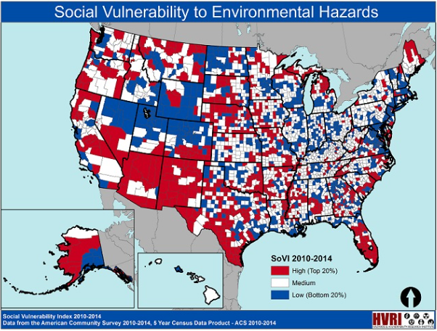
Overview of Presentation
Exploring Social Vulnerability:
What is it?
What Data to Use?
How to Make It?
The Good and the Bad
Real-World Examples
Key Takeaways
Put It In Action
Notes:
How I will achieve this goal.
***panel of three disaster photos staggered zigzag – or GIS,
GIF

Slide 3
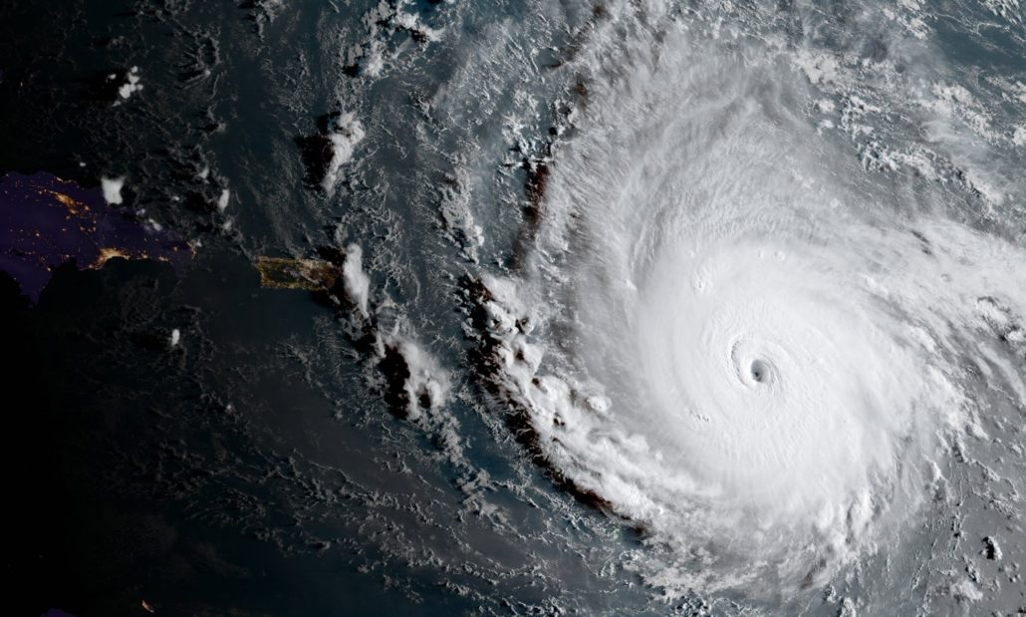
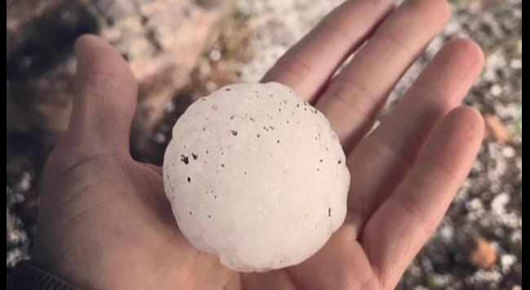
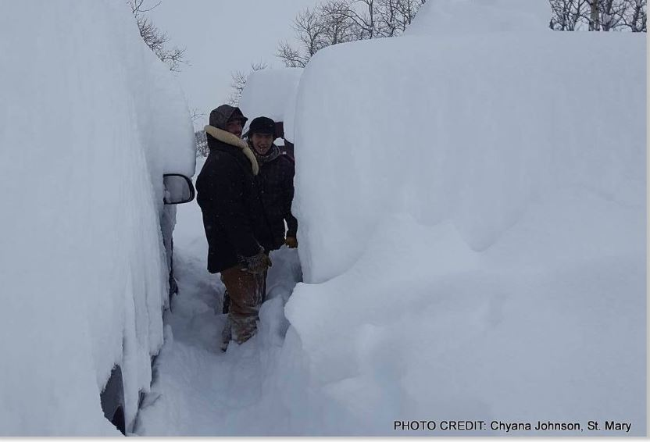
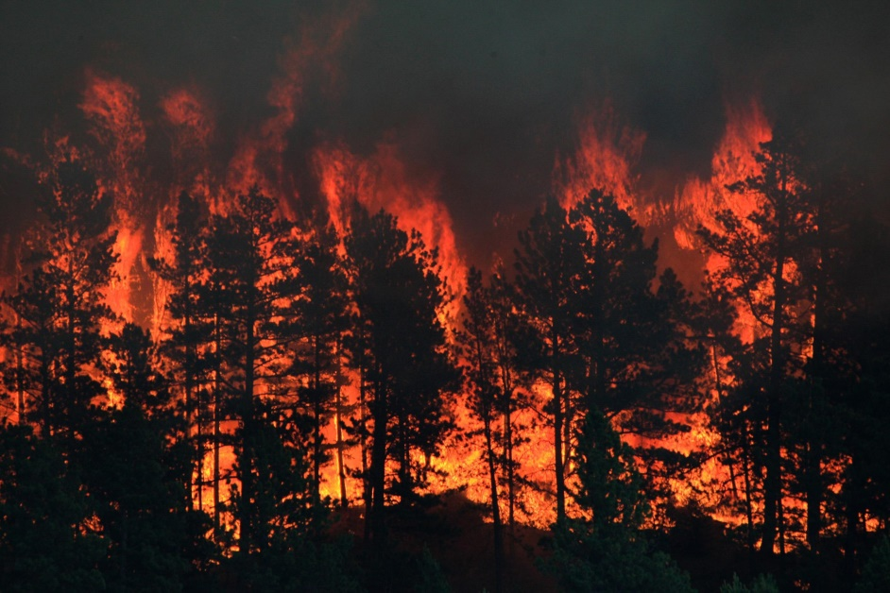
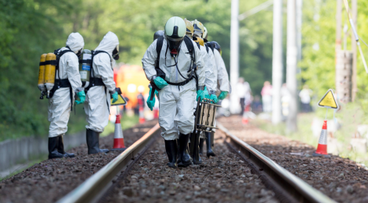
{Emergency Managers are BUSY!}
Notes:
Tornado: https://www.weather.gov/ilx/28feb17
Hurricane: http://heartswithhands.org/2017/09/08/september-7-2017-hurricane-irma/
Hail: https://weather.com/storms/severe/news/hailstorm-denver-colorado-impacts
Blizzard: http://strangesounds.org/2017/02/biggest-blizzard-of-the-year-hits-northeast-us-5-feet-snow-montana-14-inches-boston-new-york-city.html
Hazmat: http://kanecountyconnects.com/2017/06/lepc-ensures-quality-hazmat-response-with-help-from-some-friends/
Fire :http://www.spokesman.com/stories/2017/jul/07/north-central-montana-wildfire-grows-to-13-square-/#/0

Slide 4
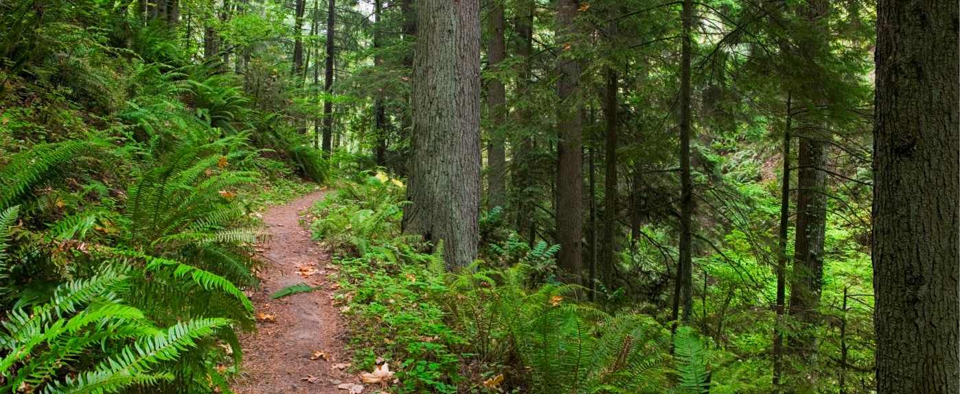
EM’ing with Purpose:
We wear many hats…
We need all the help we can get!
Preparedness Activities
Outreach
Resource Assessment
Preplanning
Mitigation
SV helps point us in the right direction; Maximizing our energy:
A guide to serve our communities that need it to most
Saves lives and money
Notes:
Get 5 caps with large printed roles on them
1. Plans, Annexes, and Exercises
2. Social Media Manager
3. Educational Outreach
4. Exercise Planner and Coordinator
5. Weather Forecaster and NWS Liaison
6. EOC Manager
What if I told you… there is a tool to help us focus our job tasks in areas of greater need first? In areas that will do the most good initially?
Many Hate Photo: http://www.projectmanage.com/the-world-of-project-management-and-its-many-hats/
Trail: https://www.forestparkconservancy.org/tales-from-the-trails/trails-assistant-job-opening

Slide 5
What the heck is social vulnerability? And why should I use it?
Notes:
GIF:

Slide 6
Social Vulnerability: What Is It?
Vulnerability: Human induced situation caused by variables like resource distribution that heavily impacts disaster outcomes
Types:
Physical
Psychological
Social
Social: Demographic characteristics = social makeup
New concept
Notes:
Chakraborty et al. 2005, 24
Anderson, 1994
Chain: https://www.hitachi-systems-security.com/4-0-4/

Slide 7
Supporting Research
Many studies found a link between social variables and injury/death
Race/Ethnicity, Age, Income, Household Characteristics, Education
Regions of High SV thought to have less storm resources available and more likely to:
Be less prepared
Suffer injury or death
Have the most financial damage
Notes:
Senkbeil et al., 2012, 160, 164-170
Balluz et al. 2000, 73-76
Collins and Kapucu 2008, 590-591

Slide 8
Emergency Management Relevancy
What does this mean to us?
What if we could target highest risk areas with action to reduce risk?
Target and Steer
Create and Change
Save and Minimize
Notes:
So now that I have hopefully explained and convinced you of why SV is useful in EM, lets talk about how we can create an SVI for usage.
Target: http://www.psdgraphics.com/wp-content/uploads/2014/09/dart-on-target.jpg
Blocks: https://whatsupusana.com/wp-content/uploads/2012/08/Blocks.jpg
Person: https://cdn.pixabay.com/photo/2012/04/26/19/47/man-42934_960_720.png
Property: https://www.bing.com/images/search?view=detailV2&ccid=uKpo2E0p&id=80D5C641CC4566169749639536F001446A56D008&thid=OIP.uKpo2E0pA_bPY8ekjyiVjgHaFP&mediaurl=http%3a%2f%2fwww.freevector.com%2fsite_media%2fpreview_images%2fFreeVector-City-Skyscrapers-Vector.jpg&exph=724&expw=1024&q=sky+scraper+clipart&simid=608037736397670654&selectedIndex=34&ajaxhist=0
Money: https://thumbs.dreamstime.com/x/vertical-background-dollar-bills-16088946.jpg

Slide 9
SOCIAL VULNERABILITY INDEX: How To Make it

Slide 10
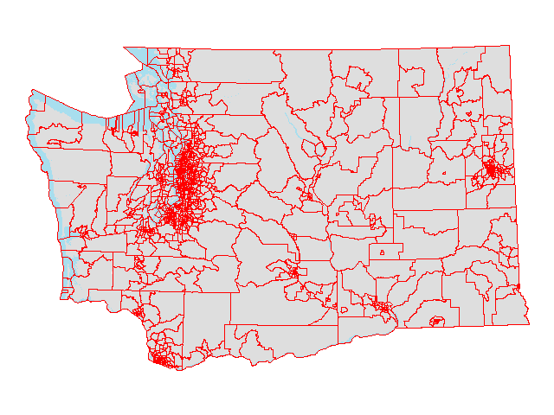
Data
American Community Survey Census Data Tables
Block Group: Most Detailed
5 Year Data: 60 months of sampled data
Jurisdiction Census Block Group Shapefile
Mapping Software
GIS Guru
Third party company
Notes:
*1/38 citizens receive the survey each year – get a follow-up visit or call if not returned within a certain time
Survey is sampled, leading to sampling error that can be higher in some variables than others
5 year data gives the largest sampling size for added accuracy
Census: https://gcn.com/~/media/GIG/GCN/Redesign/Articles/2017/January/census2.png
Census Block: https://gcn.com/~/media/GIG/GCN/Redesign/Articles/2017/January/census2.png
ESRI: https://yizhuangfanggeospatial.files.wordpress.com/2015/09/esri_arcmap_transparente.png

Slide 11
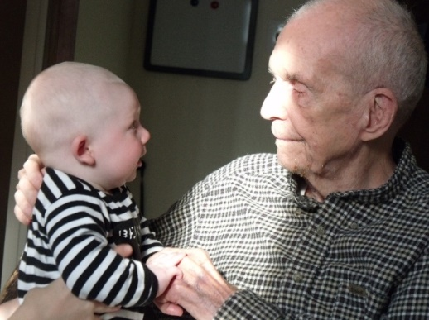
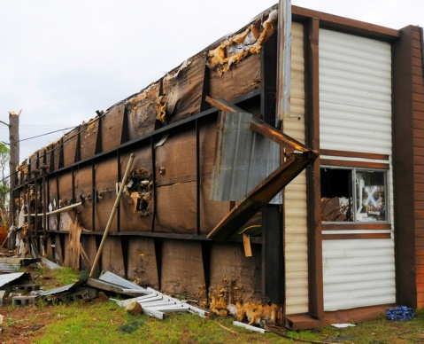
Choosing Variables
Variables consistent in research are:
Variables can be added or subtracted based on the goals of the SVI map, but these are good defaults
RACE &
ETHNICITY
HOUSEHOLD
TYPE
AGE
INCOME
EDUCATION
Notes:
Minority Population: Translation of warning information
Minors and Elderly: More dependent on others for care; mobility; Personal Beliefs
Poverty Line: Lack of preparedness supplies/insurance
Trailer Homes/Apt, Vehicle Access, and HH Makeup
No HS Diploma: Miss out on emergency/government assistance education
People: https://yizhuangfanggeospatial.files.wordpress.com/2015/09/esri_arcmap_transparente.png
Age: https://wagingnonviolence.org/wp-content/uploads/2013/09/037.jpg
Income: https://unibudgetlife.files.wordpress.com/2013/10/the-poverty-line.jpg
House type: http://www.city-data.com/disaster-photos/photos/40826.jpg
Education: http://images.naldzgraphics.net/2013/03/8-no-diploma.jpg

Slide 12
Social Vulnerability Index Construct
Number Assignment
Standardized
Questionnaire
Hurley, 2009
Weighted Method
EX: Chemical Factory (5)
Abandoned Warehouse (1)
Cutter, 2000; Chakraborty, 2005
Equally Weighted
EX: Ratio of each variable
Sum all Variables, Divide
Gall, 2004
Professional Input
EX: EM’s say they’ve observed Income > Age
Notes:
Column of three : graphic interpretations with 1 word bullets

Slide 13
CREATION EXAMPLE
Notes:
Insert a GIF Here

Slide 14
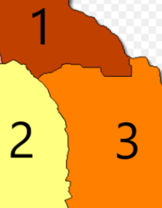
Step 1: Choose Variables
City Analysis
Census Block Group
3 Blocks Shown
Total Pop: 1000
Variables Chosen:
Income:
30 City Total
Education:
15 City Total
Age:
55 City Total
In Block 1:
Income: 17 People
Education: 9 People
Age: 22 People
In Block 2:
Income: 3 People
Education: 5 People
Age: 23 People

Slide 15
Step 2: Find the Block Ratio
Variable Block Total/Variable City Total
Block 1 Ratio
Income: 17/30 = 0.5667
Education: 9/15 = 0.6
Age: 22/55 = 0.4
Block 2 Ratio:
Income: 3/30 = 0.1
Education: 5/15 = 0.33
Age: 23/55 = 0.42
Counts of People
 | Block 1 | Block 2 | City Total
Income: | 17 | 3 | 30
Education: | 9 | 5 | 15
Age: | 22 | 23 | 55
Notes:
Divide total # in block by total # in city
Block 1: 100/1000 (0.1); Block 2: 500/1000 (0.5); Block 3: 400/1000 (0.4)

Slide 16
Step 3: Find the Ratio of the Ratios…
Find the largest ratio for each variable
Divide all ratios from last step by the largest ratio
Largest Ratio:
Income: 0.5667
Education: 0.6
Age: 0.42
Block 1 Ratio
Income: 0.5667/0.5667 = 1
Education: 0.6/0.6 = 1
Age: 22/55 = 0.4/0.42 = 0.95
Block 2 Ratio:
Income: 0.1/0.5667 = 0.18
Education: 0.33/0.6 = 0.55
Age: 0.42/0.42 = 1
Notes:
Take the highest ratio found for each variable and divide individual ratios found previously
Inception: https://www.warnerbros.com/sites/default/files/inception_keyart.jpg

Slide 17
Step 4: Sum to Create SV Index
Sum each variable score to get a total variable score
Block 1: 1 + 1 + 0.95 = 2.95
Block 2: 0.18 + 0.55 + 1 = 1.73
Divide the sum by the number of variables: (3 Variables)
Block 1: 2.95/3 = 0.98
Block 2: 1.73/3 = 0.58
Which block has the higher vulnerability?
Notes:
SV Index created by summing up the above number and dividing by total number of variables
Easy As That: https://tenor.com/view/late-night-seth-lnsm-lnsmgifs-seth-meyers-boom-gif-9198701

Slide 18
Step 5: Create Your Map
Symbolize in GIS
3 Classes
Quantile
Harvey SVI Map
Notes:
http://ucfonline.maps.arcgis.com/apps/View/index.html?appid=2c33dc0bc2da43e6a1925f60daa26e50

Slide 19
SOCIAL VULNERABILITY CASE STUDIES

Slide 20
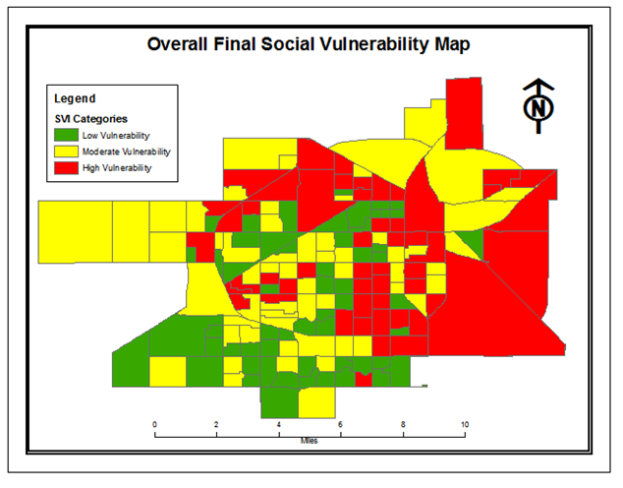
Lubbock, Texas
Variables:
Age
Race/Ethnicity
Education
Language
Income
HH Type
Home Age
Notes:
Under 18, +65 yrs; African American/Hispanic; No HS Diploma; Did not speak English well or at all; Less than 25K a year; Single parent/no vehicle/1P/6+P; 1970 or older
Income 12; Age 5; Education 3
Used 8 categories of variables for SVI
60 parcels or block groups in each category
***Touch on survey analysis afterwards (tornado shelter access, warning system method access, and educational outreach attendence)
Surveys showed high vulnerability having less shelter, warning system methods, and attending less events
Used the surveys and ran regressions to show that Income showed the best potential at being linked to storm resource access, followed by age and education. The others did not show up.

Slide 21
Williamson County, Texas
Variables:
Age
Race/Ethnicity
Education
Language
Income
HH Type
Home Age

Slide 22
Next Steps
Investigate High SV areas
Start outreach campaigns
Assess resource needs
Provide additional resources
Test improvement
Surveys (Pre/Post Incidents)

Slide 23
CLOSING REMARKS

Slide 24
SVI Pros and Cons
Pros
Cons
Simple
Moldable
Social layout
All jurisdictional types
Preplanning strategy
Free data!
ACS accuracy
Generic methods
More work to do!
Map savvy needed
Social science is hard!
Atoms vs Humans

Slide 25
Implementation
Target Areas
Situational Awareness
Educational Outreach
Safety/Resource Info
Resource Provision
Sirens
Storm Shelters
Weather Radio Drives
Mitigation Projects
Before Incident:
Know areas that may require more response resources
Response Decision-Making Tool

Slide 26
Conclusions
Importance of community characteristics
Social Vulnerability: evolving, but useful
Anyone can do it!
We need all the help we can get!
Notes:
Reference sheet for most studies cited and discussed for interested audience members
GIF: https://tenor.com/view/ratatouille-letsdothisthing-letsdothis-leggo-gif-4931943

Slide 27
Questions or Feedback?
Thank you so much for your time and attention!
Ashley E. Morris
Emergency Management Planner: Baltimore County HSEM
amorris@baltimorecountymd.gov

Slide 28
Journal References
Slide Citations:
Full References:
Slide 6: Chakraborty et al. 2005, 24; Anderson, 1994; Wisner et al., 2004 (Definitions)
Slide 7: Senkbeil et al., 2012, 160, 164-170; Balluz et al. 2000, 73-76; Collins and Kapucu 2008, 590-591 (Supporting Findings of Variables)
Slide 11: McMaster et al, 1997; Morrow, 1999, Balluz et al., 2000; Donner, 2006; Phillips and Morrow, 2007; Collins and Kapucu, 2008; Donner and Rodriguez, 2008, Flanagan et al., 2011, Senkbeil et al., 2012 (Variables agreed upon)
Slide 12: Hurley, 2009; Cutter et al., 2000; Chakraborty et al., 2005; Gall, 2004 (Index Weighting)
League et al., Emergency Manager Decision Making..., 163 (2010).
Brooks and Doswell III, Deaths in the 3 May 1999…, 354-361 (2002).
Fujita, The Lubbock tornadoes…, 169-173, (1970).
Wisner et al., At Risk…, (2004)
Cutter et al., Revealing the Vulnerability…, 715-718, (2000).
Anderson, Understanding the disaster-development continuum…, 8, (1994).
Wilson and Oyola-Yemaiel, Emergenct Coordinative Groups…, (1998).
Dixon & Moore, Tornado Vulnerability in Texas…, (2012).
Flanagan et al., A Social Vulnerability Index…, (2011).
Hurley, Planning and Mitigation…, (2009).
Chakraborty et al., Population evacuation…, 25-30, (2005).
Gall, Where to go?..., 86-91, (2004).
Paul and Stimers, Exploring probable reasons…, 1524, (2012).
Schmidlin et al., Tornado shelter-seeking behavior…, 198-200, (2008).
Balluz et al., Predictors for People’s Response…, 75-76, (2000).
Collins and Kapucu, Early Warning System…, 590 (2008).
Liu et al., Assessment of a Severe-Weather Warning…, (1996)

Slide 29
Photo References
SVI Map: http://artsandsciences.sc.edu/geog/hvri/sovi%C2%AE-0
Tornado: https://www.weather.gov/ilx/28feb17
Hurricane: http://heartswithhands.org/2017/09/08/september-7-2017-hurricane-irma/
Hail: https://weather.com/storms/severe/news/hailstorm-denver-colorado-impacts
Blizzard: http://strangesounds.org/2017/02/biggest-blizzard-of-the-year-hits-northeast-us-5-feet-snow-montana-14-inches-boston-new-york-city.html
Hazmat: http://kanecountyconnects.com/2017/06/lepc-ensures-quality-hazmat-response-with-help-from-some-friends/
Fire :http://www.spokesman.com/stories/2017/jul/07/north-central-montana-wildfire-grows-to-13-square-/#/0
Many Hate Photo: http://www.projectmanage.com/the-world-of-project-management-and-its-many-hats/
Trail: https://www.forestparkconservancy.org/tales-from-the-trails/trails-assistant-job-opening
Chain: https://www.hitachi-systems-security.com/4-0-4/
Target: http://www.psdgraphics.com/wp-content/uploads/2014/09/dart-on-target.jpg
Blocks: https://whatsupusana.com/wp-content/uploads/2012/08/Blocks.jpg
Person: https://cdn.pixabay.com/photo/2012/04/26/19/47/man-42934_960_720.png
Property: https://www.bing.com/images/search?view=detailV2&ccid=uKpo2E0p&id=80D5C641CC4566169749639536F001446A56D008&thid=OIP.uKpo2E0pA_bPY8ekjyiVjgHaFP&mediaurl=http%3a%2f%2fwww.freevector.com%2fsite_media%2fpreview_images%2fFreeVector-City-Skyscrapers-Vector.jpg&exph=724&expw=1024&q=sky+scraper+clipart&simid=608037736397670654&selectedIndex=34&ajaxhist=0
Money: https://thumbs.dreamstime.com/x/vertical-background-dollar-bills-16088946.jpg
Census: https://gcn.com/~/media/GIG/GCN/Redesign/Articles/2017/January/census2.png
Census Block: https://gcn.com/~/media/GIG/GCN/Redesign/Articles/2017/January/census2.png
ESRI: https://yizhuangfanggeospatial.files.wordpress.com/2015/09/esri_arcmap_transparente.png
People: https://yizhuangfanggeospatial.files.wordpress.com/2015/09/esri_arcmap_transparente.png
Age: https://wagingnonviolence.org/wp-content/uploads/2013/09/037.jpg
Income: https://unibudgetlife.files.wordpress.com/2013/10/the-poverty-line.jpg
House type: http://www.city-data.com/disaster-photos/photos/40826.jpg
Education: http://images.naldzgraphics.net/2013/03/8-no-diploma.jpg
Unbalanced Scale: http://moziru.com/images/scale-clipart-uneven-5.jpg
Balanced Scale: https://i.pinimg.com/736x/8b/2d/4a/8b2d4a5b918d89942abd070ff8d1fbaa--study-skills-libra.jpg
Survey: http://moziru.com/images/overview-clipart-questionnaire-17.png
Census Blocks: http://www.uflib.ufl.edu/fefdl/images/maps/income/lafincomeg.gif
Inception: https://www.warnerbros.com/sites/default/files/inception_keyart.jpg
Harvey SVI: http://ucfonline.maps.arcgis.com/apps/View/index.html?appid=2c33dc0bc2da43e6a1925f60daa26e50

Slide 30
GIF References
Surfer: https://media.giphy.com/media/v3c8uIYElXCJa/giphy.gif
Easy As That: Easy As That: https://tenor.com/view/late-night-seth-lnsm-lnsmgifs-seth-meyers-boom-gif-9198701
Let’s Do This Thing: https://tenor.com/view/ratatouille-letsdothisthing-letsdothis-leggo-gif-4931943

