Slide 1
Your Partners in Emergency Management
Notes:
The content in this presentation shall not be changed, altered or used without explicit approval by EM Partners.

Slide 2
Thank you!

Slide 3
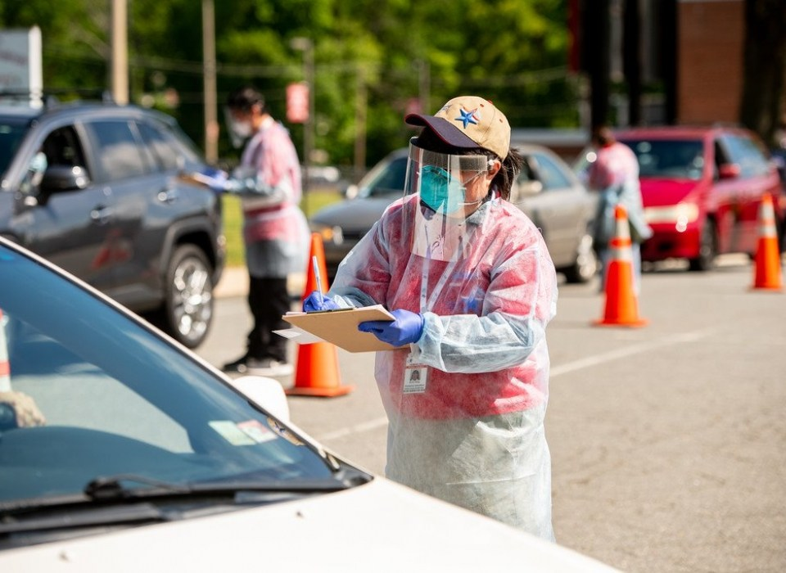
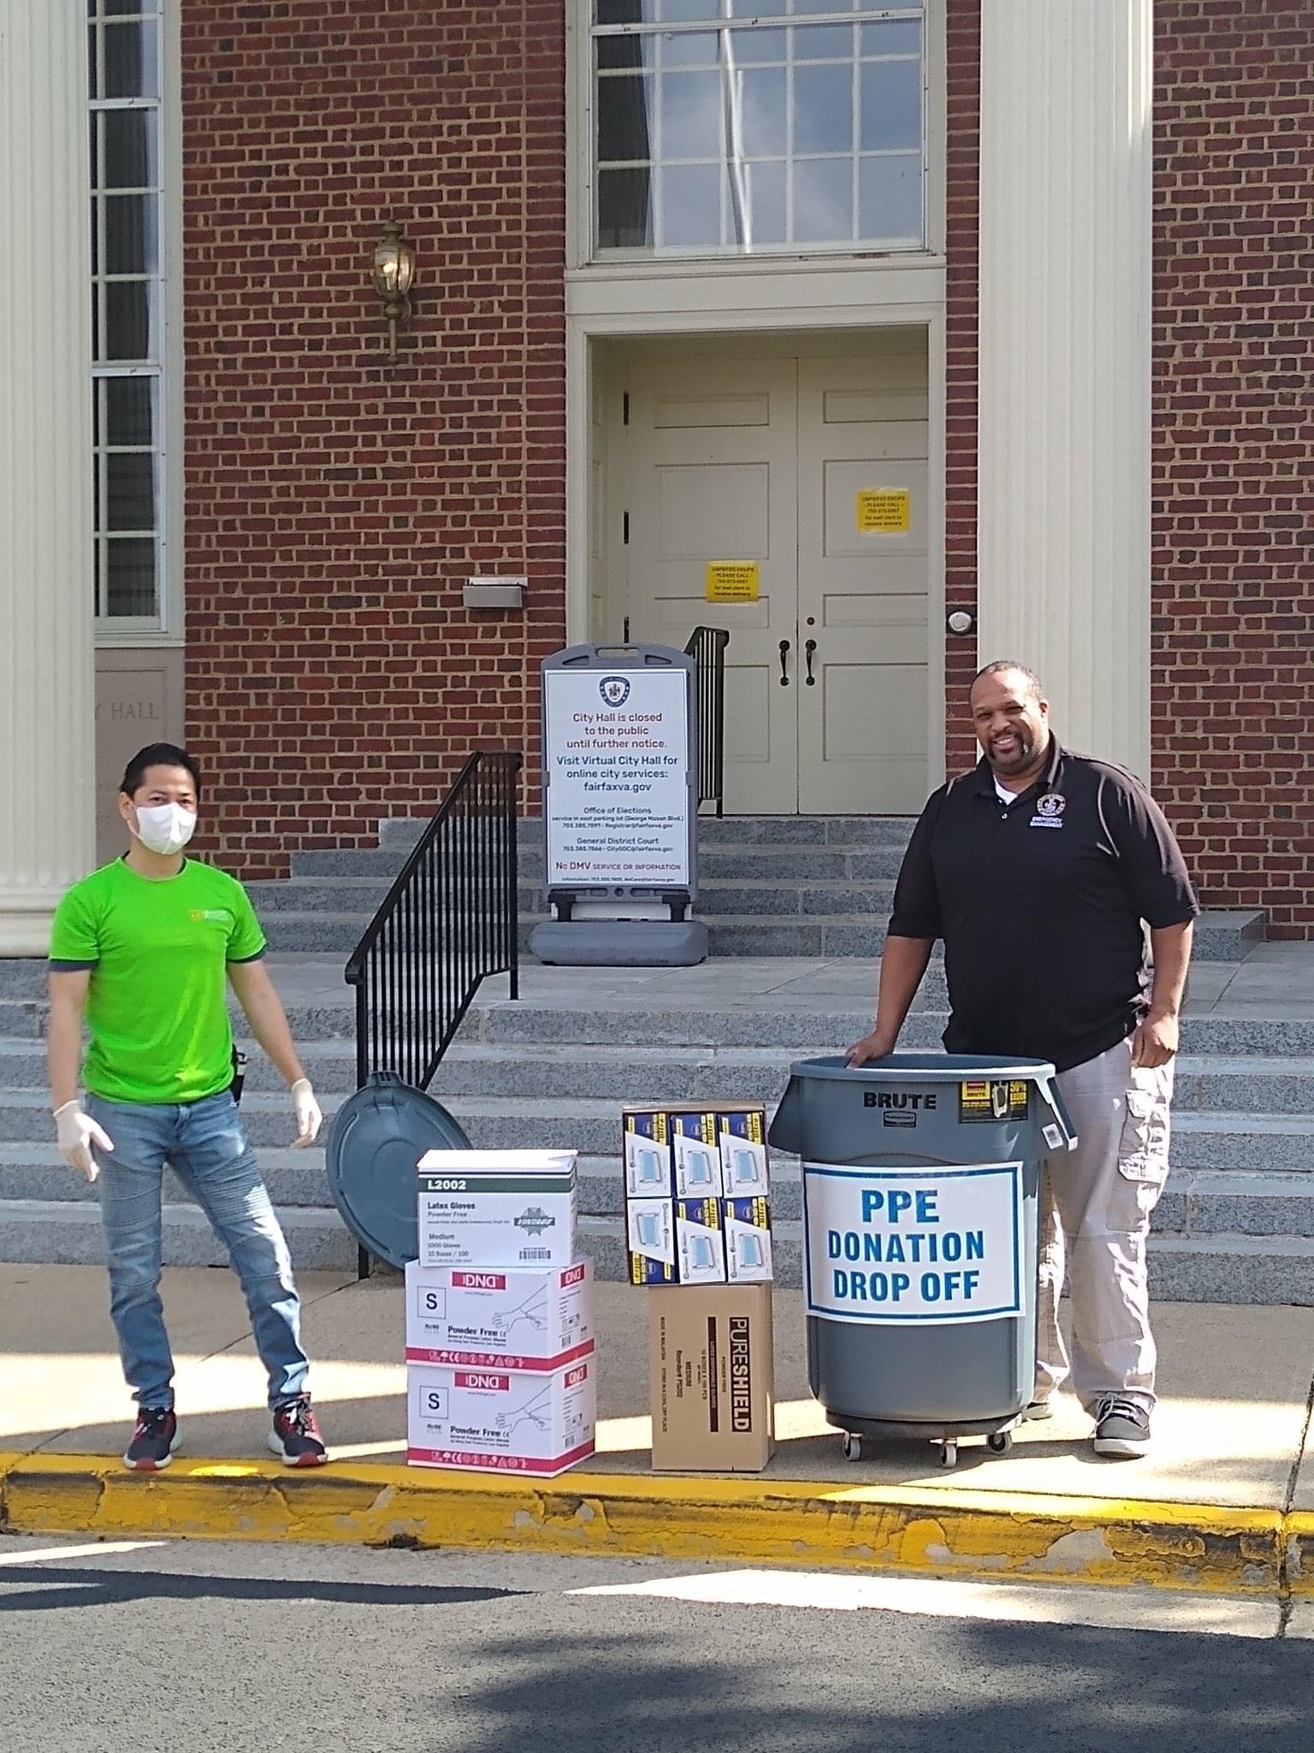
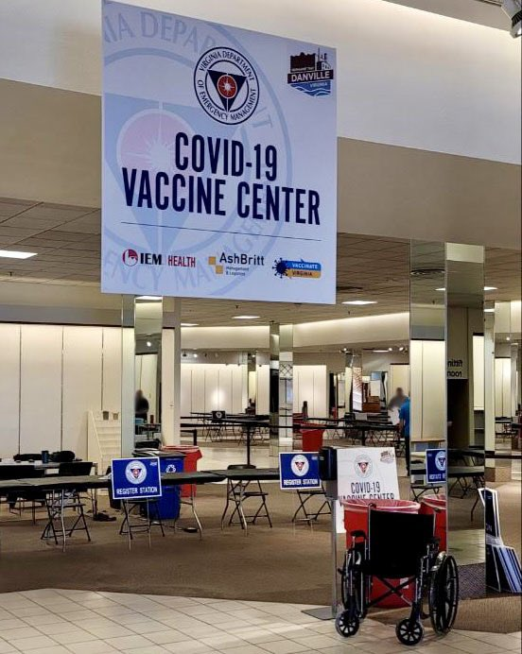
Our passion for the work we do has grown as we have watched each and every one of you put your hearts and your souls into your work like never before.

Slide 4
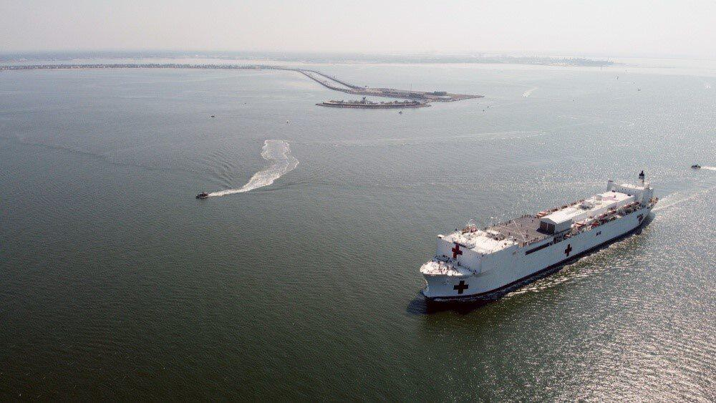
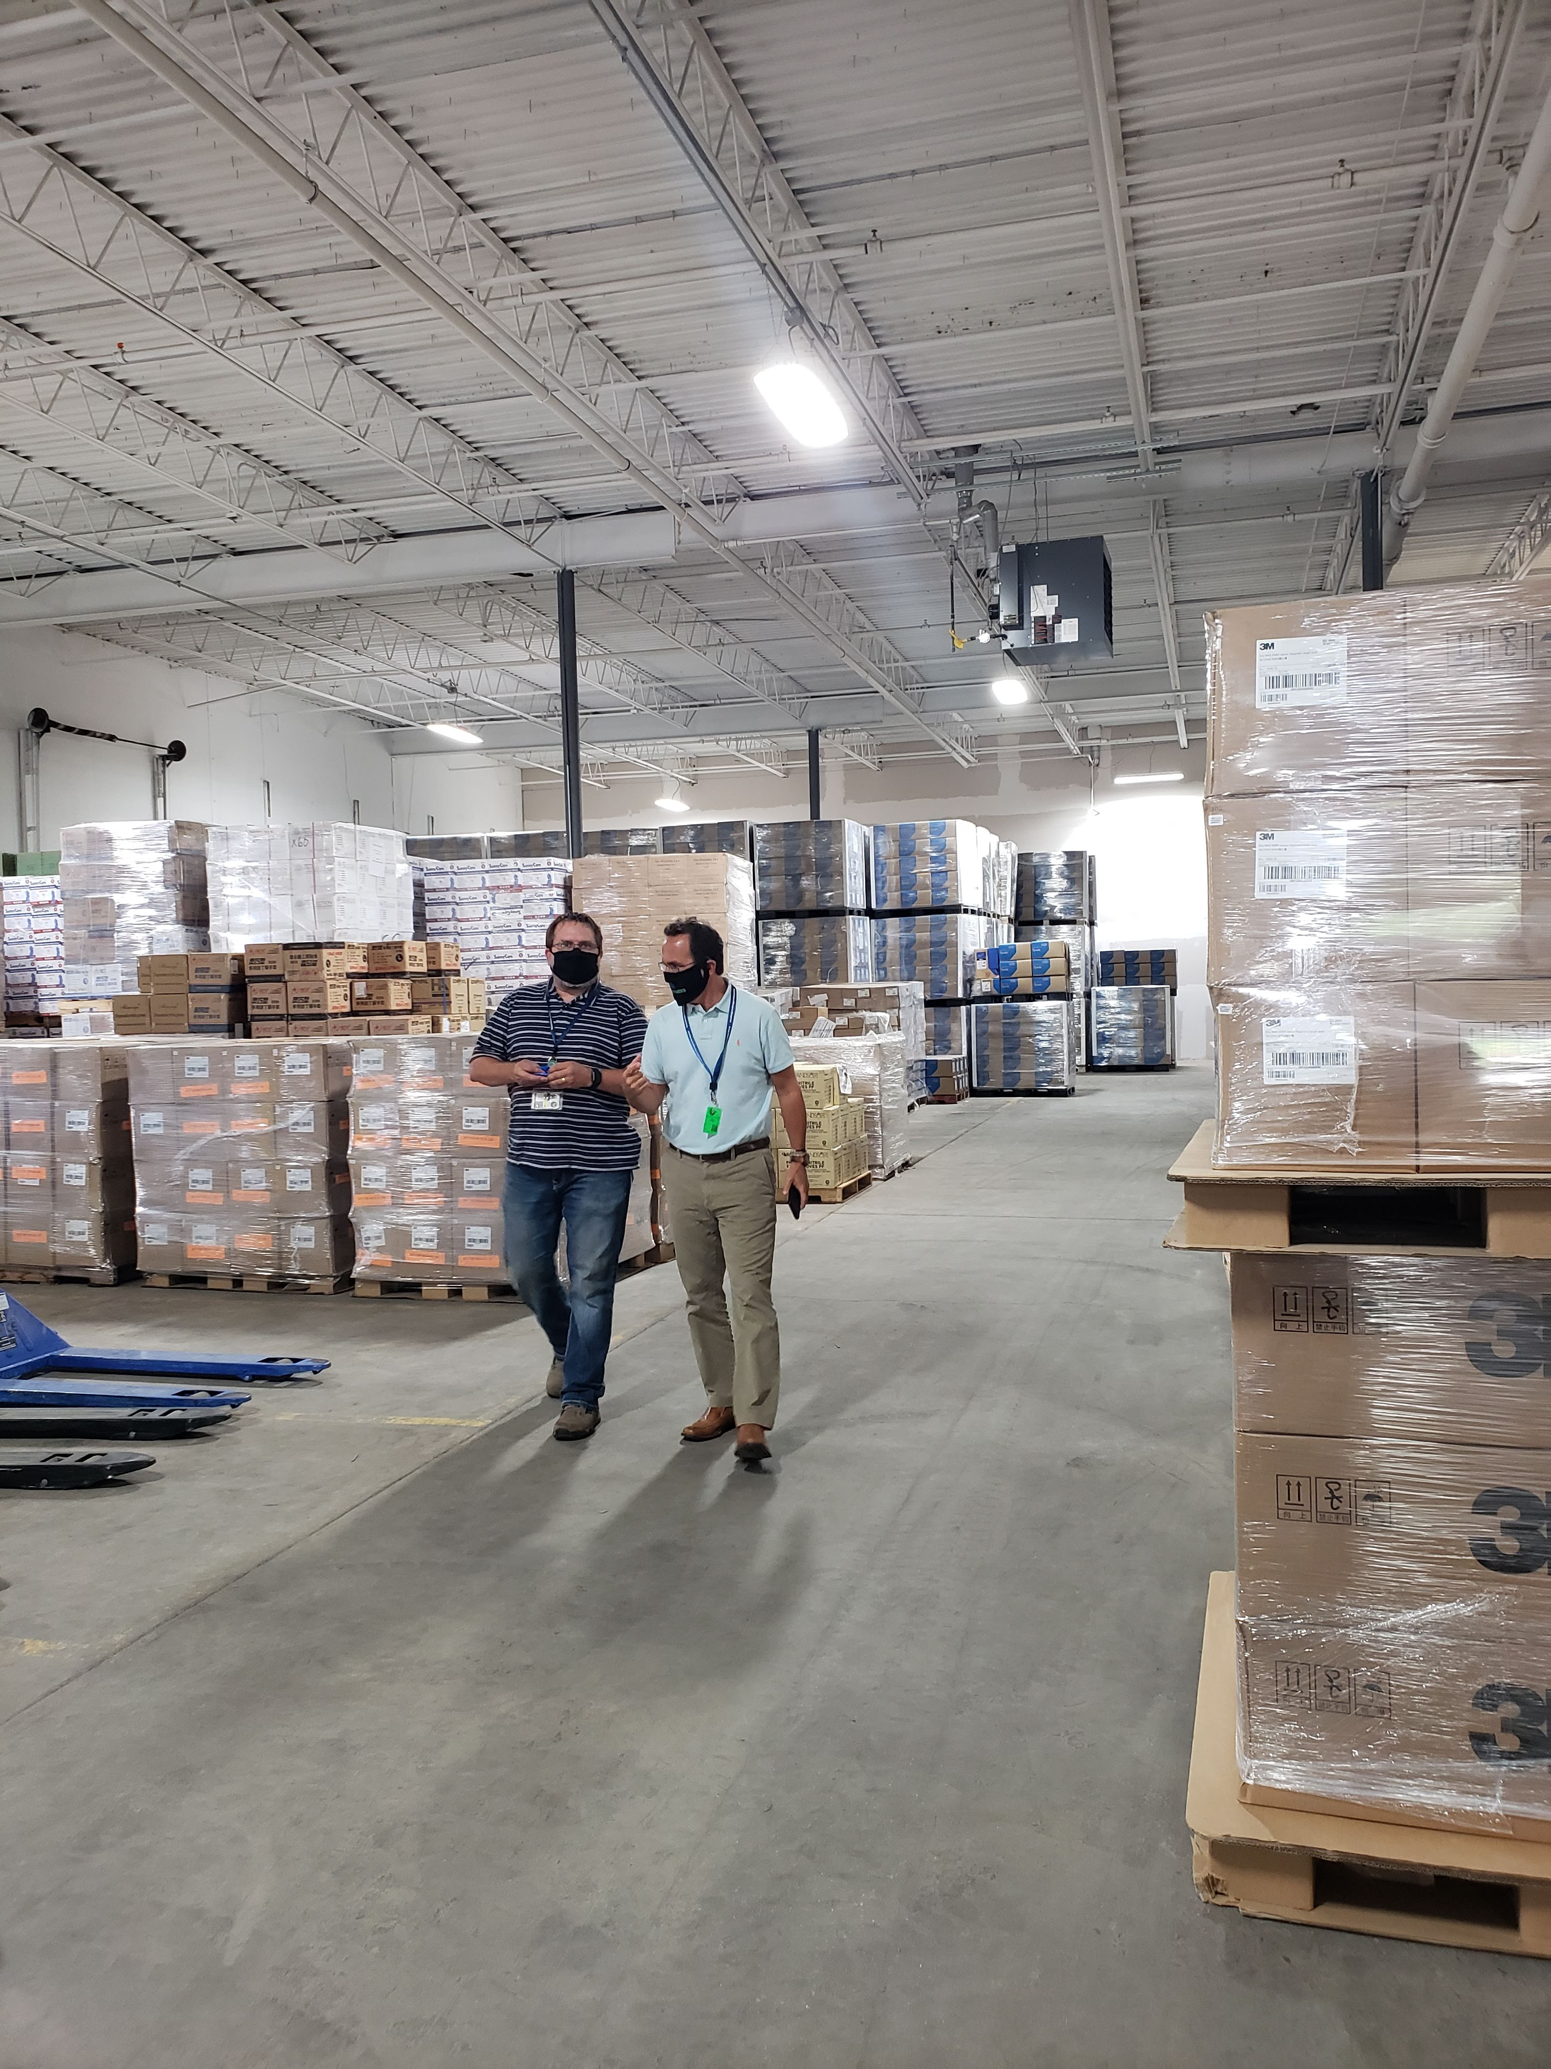
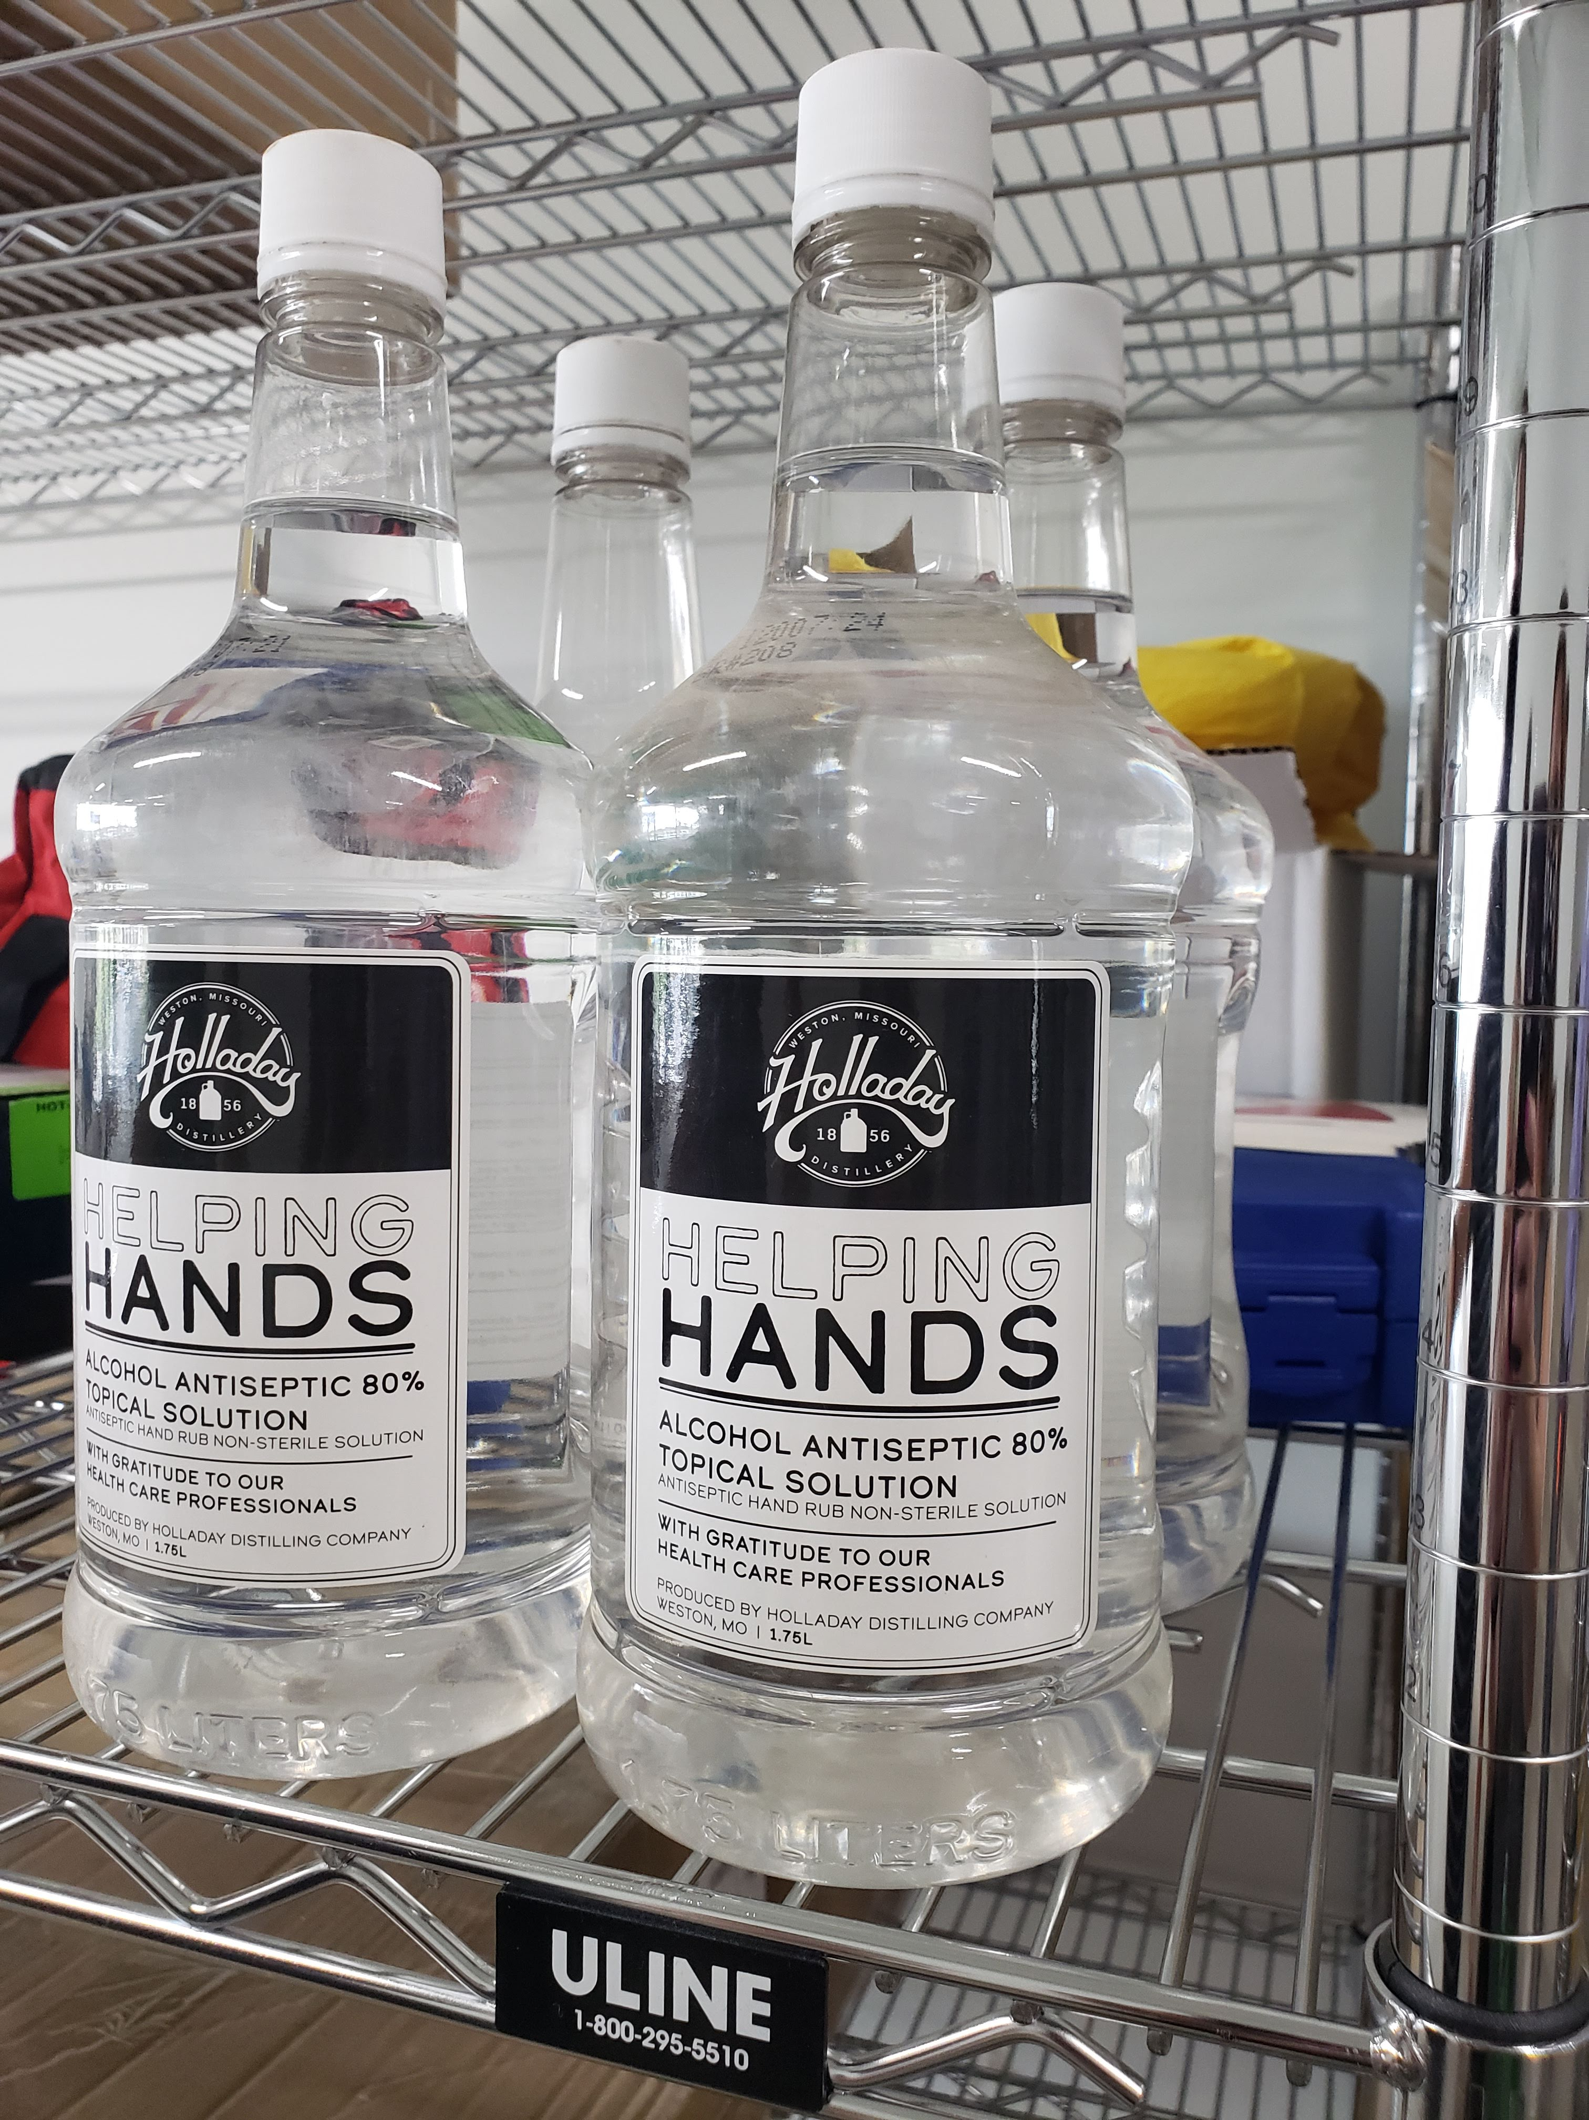
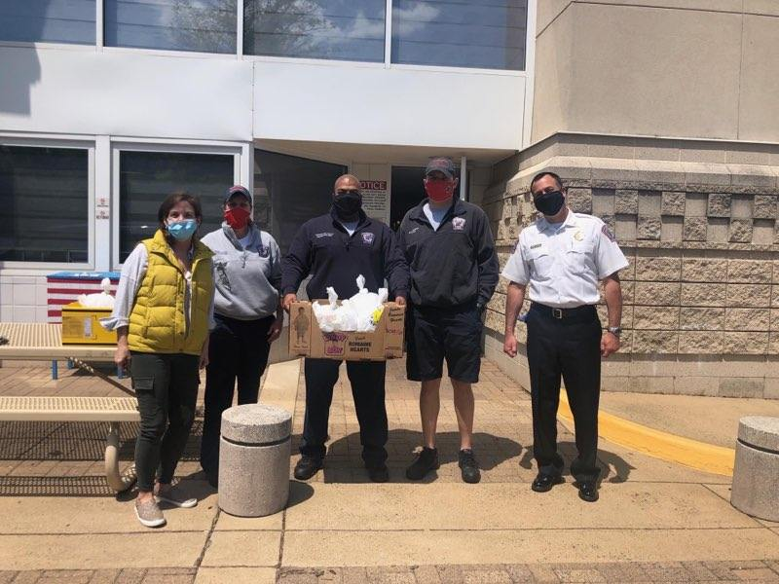
For that hard work and dedication, we’d like to say thank you!

Slide 5
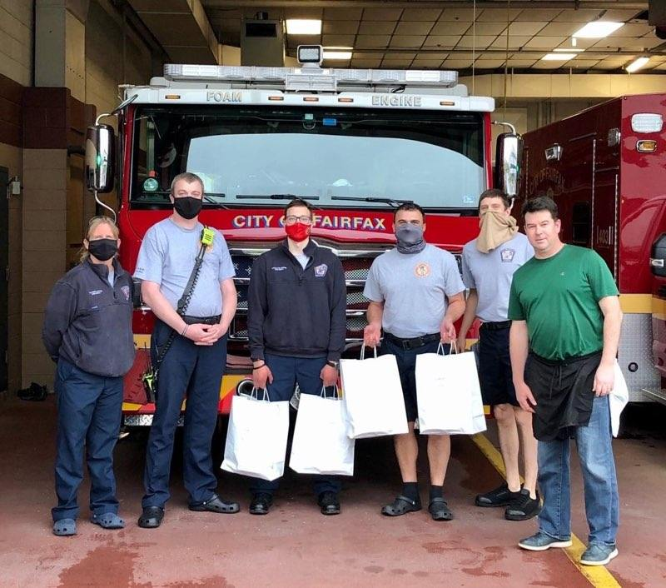
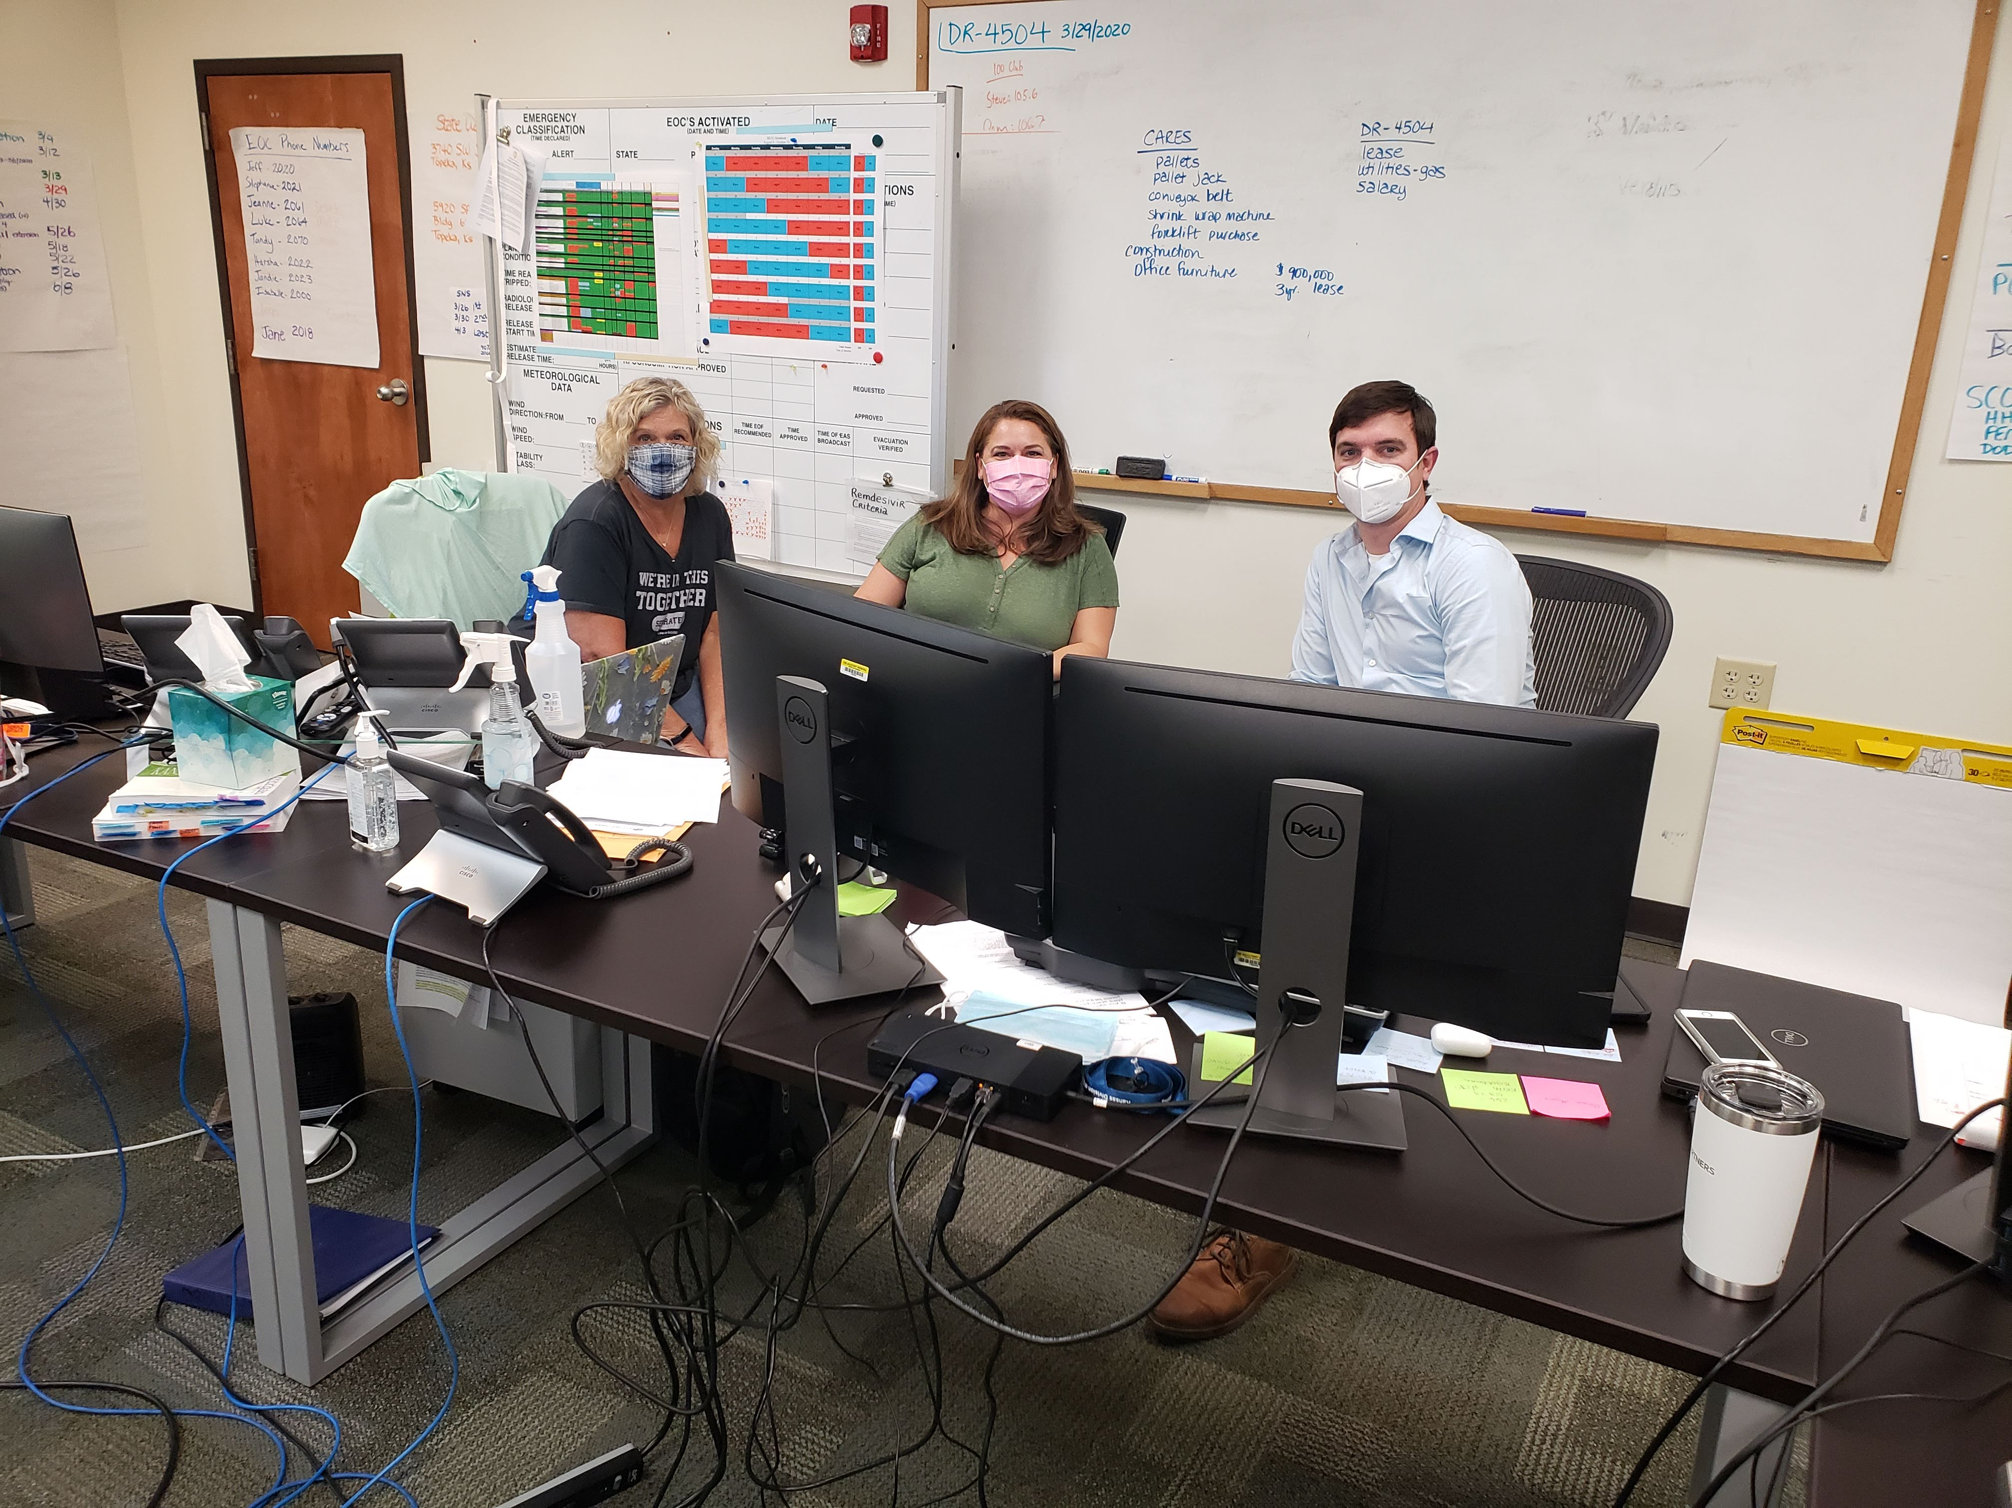
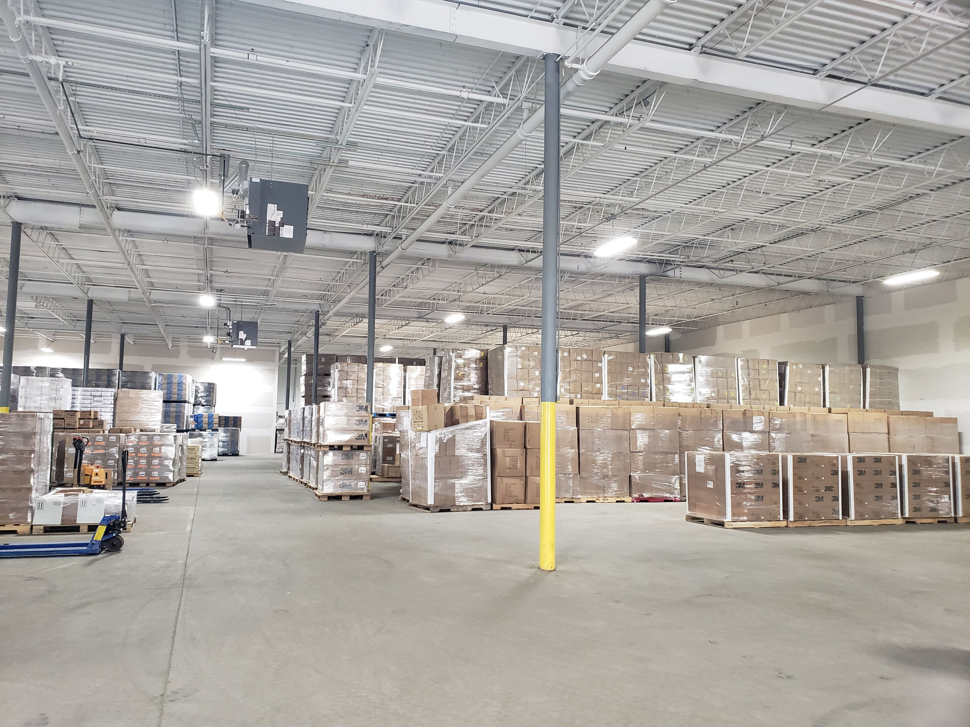
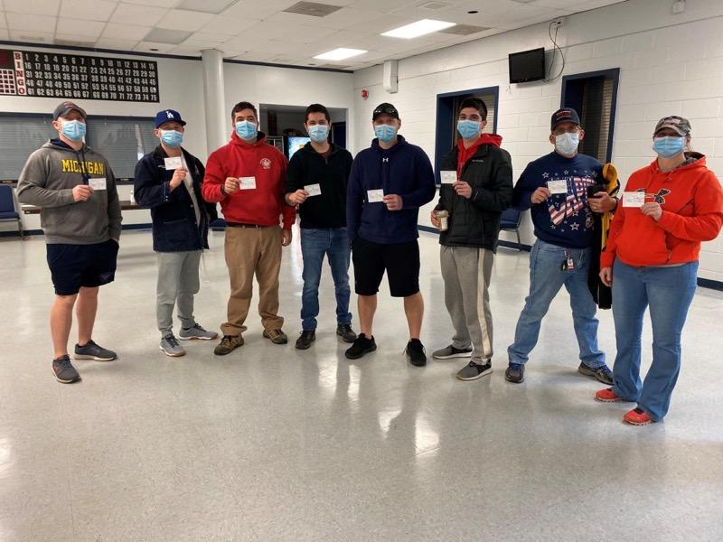
It has been an honor to work side-by-side with many of you this past year.

Slide 6
Who we are
EM Partners was founded in 2015 by Paul Manno as primarily a disaster recovery firm.
In 2019, he had a vision to expand the company’s offerings to include planning, preparedness and program support.

Slide 7
What we do
Comprehensive, tailored emergency management consulting

Slide 8
Preparedness
Pre-Disaster Preparations
Preparedness Program Development/Delivery/Improvement
Emergency Operations Planning
Recovery Planning
Continuity of Operations Planning
Private Sector Engagement Support
Companion Animal Planning
Disaster Planning - Individuals and Families/Small Business/Houses of Worship
Evacuation and Re-entry Planning
Gap Analysis and Plan Review
Hazard Vulnerability Assessment (HVA) Review
Emergency Management Strategic Planning
Debris Management Planning
Exercise Development/Delivery (Homeland Security Exercise Evaluation Program - HSEEP)
Safety/Security/Risk/Preparedness Assessments

Slide 9
Response
Initial Damage Assessments
EOC Surge Support Personnel
Volunteer Management
Debris Volume/Type Assessments
Debris Operations and Management Planning

Slide 10
Recovery
Public Assistance (PA) grants management (FEMA) and support
Cost Estimating
Insurance Claim Support
Financial Recovery and Reconciliation
Appeals and Arbitration
BRIC and Hazard Mitigation (HM) Proposal Development 404 & 406
Environmental and historical preservation (EHP) assessments
After Action Review (AAR) development

Slide 11
Why we do it
Passion to support our communities and partners like you!

Slide 12
Who our Virginia Partners are
Virginia Department of Emergency Management
Virginia Department of Health
City of Fairfax
Fairfax County
Fairfax County Public Schools
Rural Electric Cooperatives

Slide 13
Other Partners we work with
Federal Emergency Management Agency
Kansas Division of Emergency Management
State of Oregon
State of Delaware
Commonwealth of Kentucky
National Association of Regulatory Utility Commissions
Electric Infrastructure Security Council
City of Panama City, Florida

Slide 14
How we can be your Partner in Emergency Management
Virginia Department of Emergency Management Multi-use Contract
City of Fairfax Emergency Management Support Contract
Certified VA SWaM

Slide 15
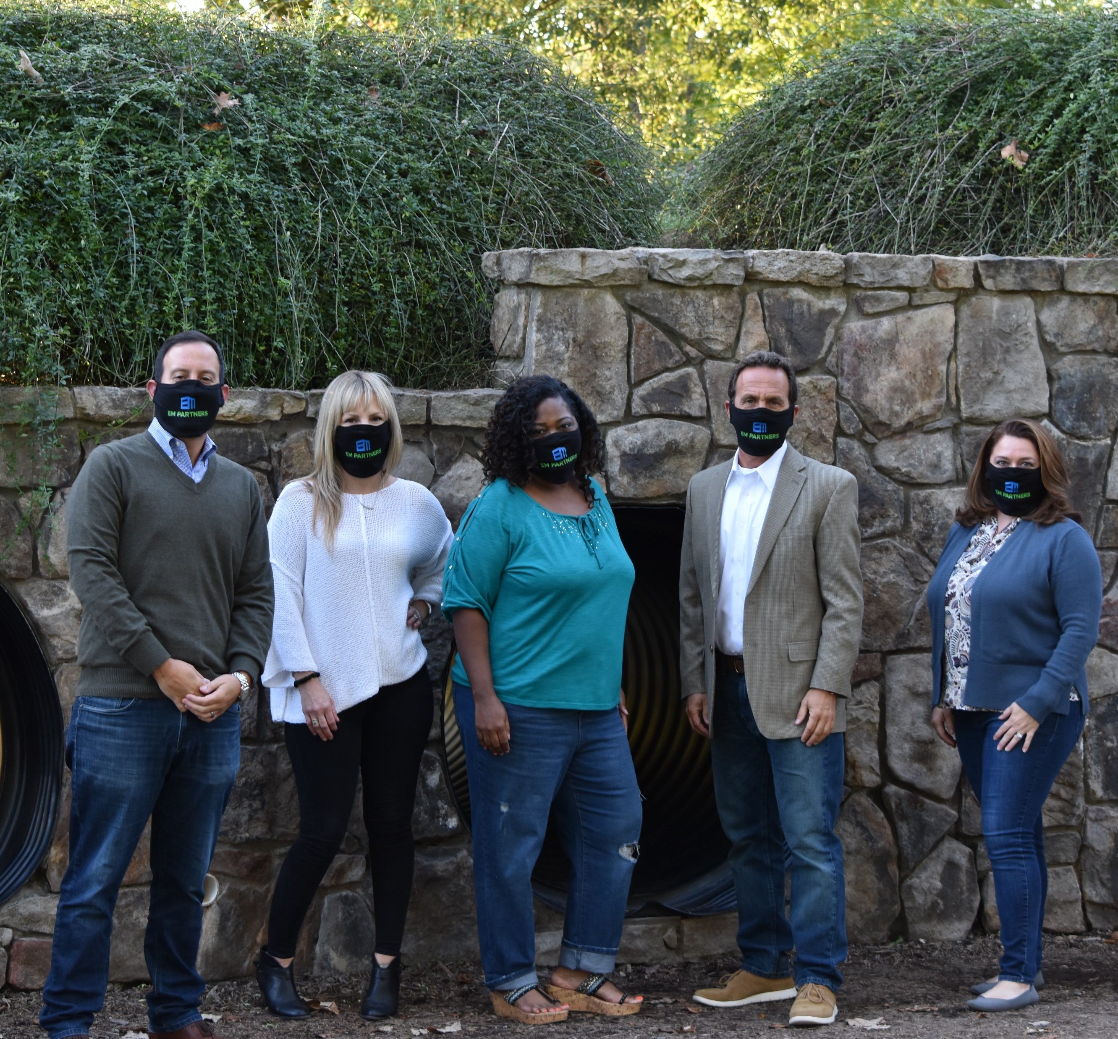
We look forward to continuing our Partnerships and creating new ones in Virginia.

Slide 16
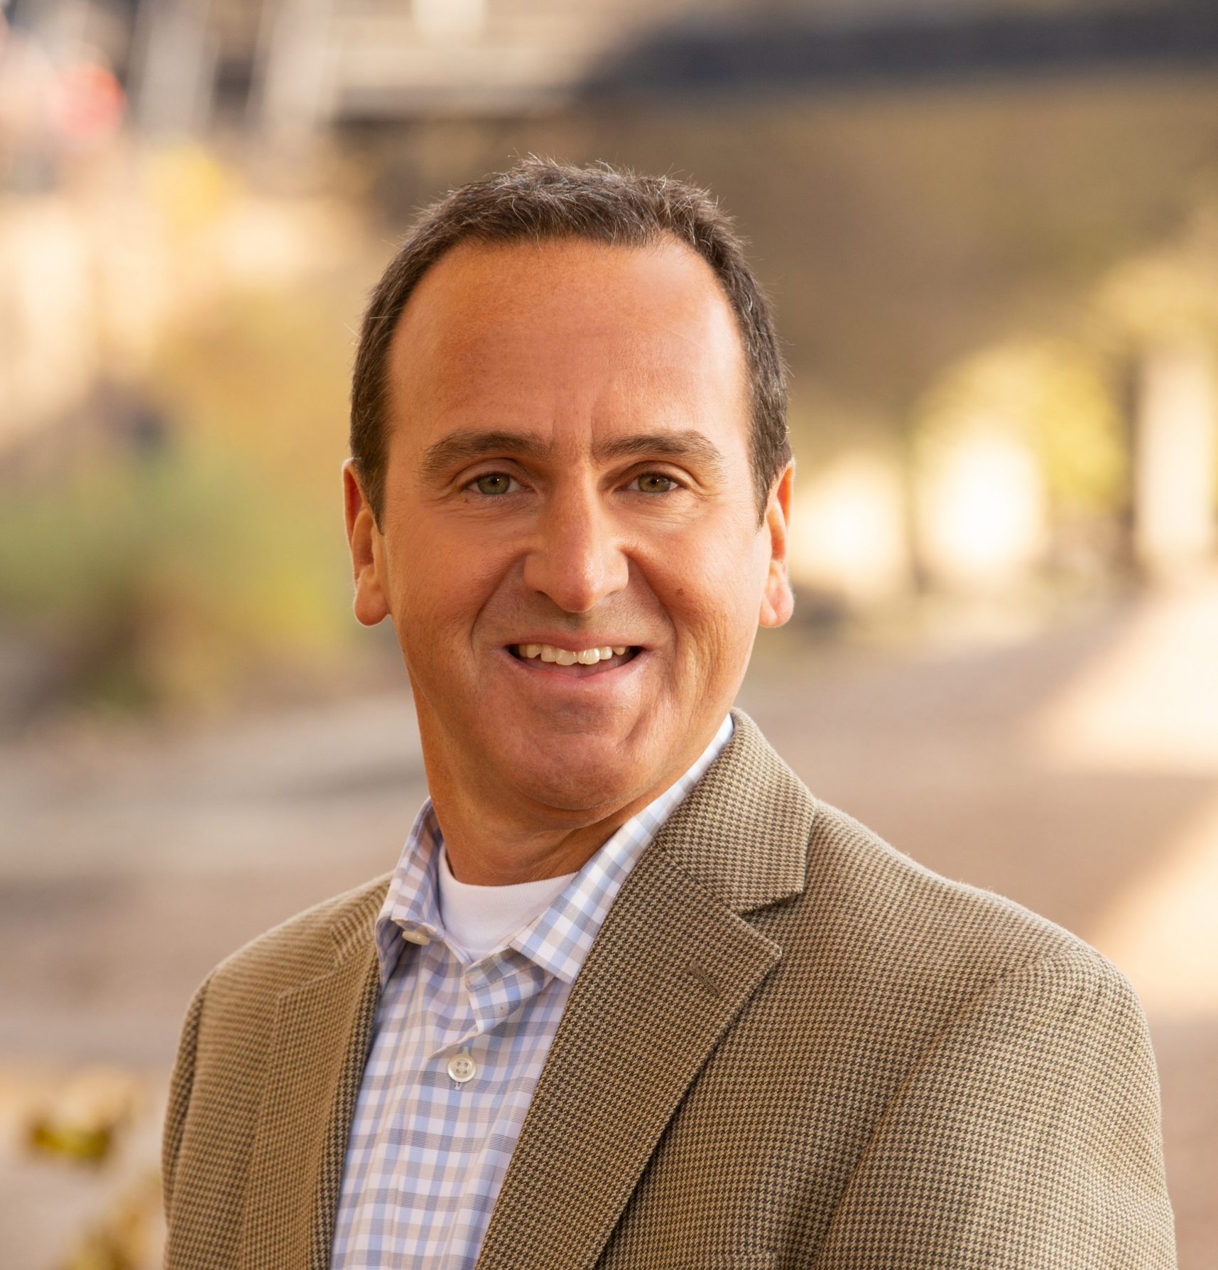
Contact us at:
Paul Manno, President
804-304-4822 paul@em-partners.com
Shandi Treloar, Vice President
703-507-7001 shandi@em-partners.com
www.em-partners.com

