Slide 1
Commanding The Chaos Interstate 64 Queens Creek Bridge

Slide 2
Commanding The Chaos Interstate 64 - Queens Creek Bridge
York County Department of Fire and Life Safety
Office of Fire Administration
Fire and Rescue Operations Division
Prevention and Community Safety Division
Animal Services Bureau
Technical Services and Special Operations Division
Support Services Division
Office of Emergency Management
Notes:
BC/EMS Sup/Engines/Ladders typically staffed with ALS certified personnel

Slide 3
Commanding The Chaos Interstate 64 - Queens Creek Bridge
York County Department of Fire and Life Safety
Six Fire Stations – (Seventh under construction)
Battalion Chief/EMS Supervisor/Six Engines/Two Aerials/Two Heavy Rescues/Six ALS Medic units
153 Uniformed Fire and Life Safety Personnel and Staff
Special Teams
Marine-MIRT/ROVER/HTR-TRT/Haz-Mat/MMRS logistics/Dive
Notes:
BC/EMS Sup/Engines/Ladders typically staffed with ALS certified personnel

Slide 4
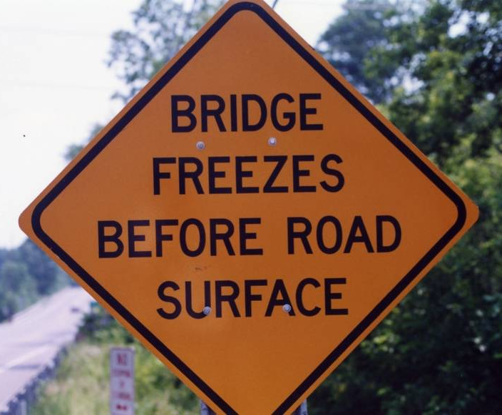
Commanding The Chaos Interstate 64 - Queens Creek Bridge
Reported from Weather Station @ Jamestown/Williamsburg Airport
Temp: 32 degrees
Relative Humidity: 100%
Wind Direction: North
Wind Speed: calm
Visibility: less than 0.25 miles
Cloud Cover: overcast @ 100 feet / freezing fog

Slide 5
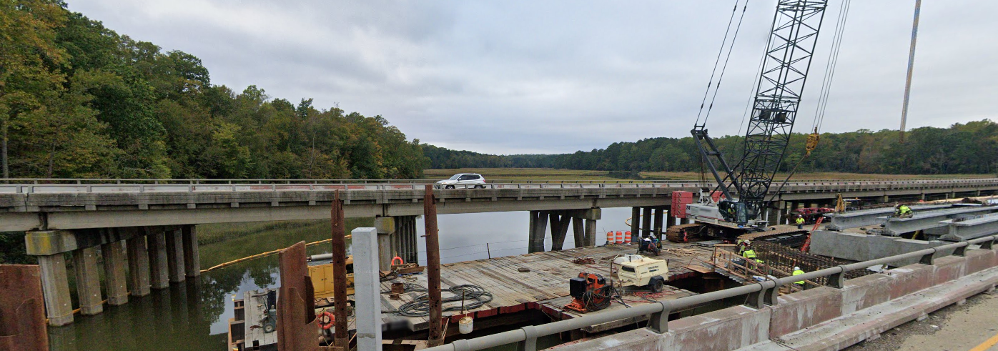
Commanding The Chaos Interstate 64 - Queens Creek Bridge
I-64 West at Queens Creek Bridge – Under Expansion
Notes:
Brief overview of I64 project. Status of bridge at time of accident.

Slide 6
Commanding The Chaos Interstate 64 - Queens Creek Bridge
I-64 West,
Quarter Mile
Before 238 exit
Notes:
Typically, accidents on the interstate are received quickly by passerby or persons involved. Generic dispatch process are standard for any incident.

Slide 7
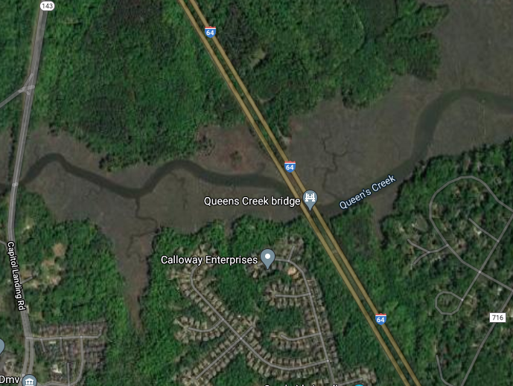
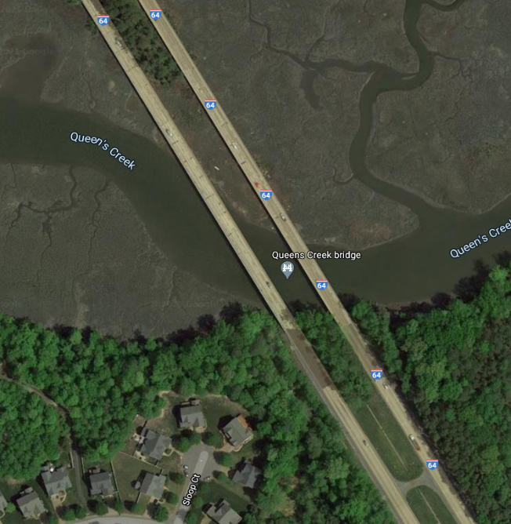
Commanding The Chaos Interstate 64 - Queens Creek Bridge
I-64 Queens Creek Bridge – Limited Access
Notes:
Almost always, incidents are modified with additional information from persons on scenes. Discuss typical incident response for extrication on the interstate.
Thoughts of the responders as the incident is evolving in their minds of “multiple cars” involved, a trap, a medical stroke patient and an unconscious patient on scene. Are they all the same patient; we know our ECC does the best it can with the information provided. This scene is evolving prior to our personnel's arrival. Helicopter requested; due to fog unable to respond.

Slide 8
Commanding The Chaos Interstate 64 - Queens Creek Bridge
Notes:
E5 assessing the scene. Good calm voice sets the stage for the stress they are approaching. Location clarified. Slightly off on vehicle count, but who could assess the number of vehicles piled upon each other in a short span?
E3 and L3 arriving on scene, marked command and channel assignment. Investigating. All personnel maintained their composure across the radio, reducing stress of all involved.
Command requesting resources. Personnel identified the need for mass transit off of the interstate and potential volume of patients. Requesting MCI3 triggers command staff and activation of an MCI event.

Slide 9
Commanding The Chaos Interstate 64 - Queens Creek Bridge
Significant Incident Updates
07:49 Call Dispatched
08:00 First Units on Scene E3/R3/L3
08:00 Command Established by L3, Tac3
08:04 Requested MCI Bus (MCI Declaration)
08:24 Additional Accident, Injuries – I-64 E @ MM238, opposite side of QC Bridge
08:25 First patients – M3 transported two to RDH
08:37 North & South Operations Areas Established
08:37 YC MCI-3 Bus on Scene
08:57 Additional Accident, No Injuries- I-64 E @ MM238
Notes:
Two injuries in Additional accident. Refusals)

Slide 10
Commanding The Chaos Interstate 64 - Queens Creek Bridge
Significant Incident Updates – continued
09:03 2nd & 3rd MCI buses requested (Hampton/RDH)
09:07 Additional Accident, Injuries I-64 West @ mile-marker 242
10:37 Last patients transported from the scene
13:51 Eastbound lanes cleared and open
13:53 Accident reconstruction completed (VDOT)
13:53 Command Terminated
15:32 Scene cleared (VDOT) – all traffic released

Slide 11
Commanding The Chaos Interstate 64 - Queens Creek Bridge
Unified
Command
North Area
EMS-1
South Area
Chief-3
MEDICAL
(Transport)
Tanker-3
Rescue
Ladder-3
Staging
Engine-3
YORK MCI-3
HAMPTON MCI
R-3
SQ-4
Riverside MCI
HAMPTON
M-10
JCC R41
USAR-4

Slide 12
Commanding The Chaos Interstate 64 - Queens Creek Bridge
Notes:
This is the view of first responders as they waded into the sea of cars to begin their START triage.

Slide 13
Commanding The Chaos Interstate 64 - Queens Creek Bridge
Notes:
Aerial of the most condensed part of the crash.
Arrow – Small white car with most significant damage.

Slide 14
Commanding The Chaos Interstate 64 - Queens Creek Bridge
Notes:
Spinal injured patient #3 extricated and transported to MCV.

Slide 15
Commanding The Chaos Interstate 64 - Queens Creek Bridge
Notes:
May make note of how many cars have already been removed. All the cars are in a very compact area.
Thoughts on the hazards we addressed: VDEM/USCG notified for potential fluids in the waterway. State Police for accident reenactment. Smart Traffic to notify travelers early of the complete road blockage. VDOT for sanding nearby road/bridges for unknown black ice.

Slide 16
Commanding The Chaos Interstate 64 - Queens Creek Bridge
Units Assisting on the Incident
59 Fire and Rescue Personnel
5 Engines
1 Tanker
4 Heavy Rescues
1 Ladder
16 Medic Units
3 Mass Casualty Buses
1 Technical Rescue/ USAR Trailer

Slide 17
Commanding The Chaos Interstate 64 - Queens Creek Bridge
Units Assisting on the Incident
2 EMS Supervisors
6 YCFLS Command Staff
31 State Troopers
8 York/Poquoson Sheriff Units
1 VDEM Staff
VDOT
2 VDOT IMC’s
4 Hospitals (RRMC, SWRMC, RDH, VCU-MCV)
Shirley Contracting
Numerous Tow Companies
Traffic Management-Diversion Company (Atlantic)

Slide 18
Commanding The Chaos Interstate 64 - Queens Creek Bridge
Mass Casualty
47 patients treated and transported by EMS
(10 more self-transported to area hospitals)
Proximity to:
RDH was 5.1 miles (7 Minutes) from the scene
SWRMC was 6.7 miles (10 Minutes) from the scene
Notes:
The establishment of a coordinating hospital in a MCI is the closes geographical local hospital. The requested hospital can defer or pass if the next hospital, preferably the regional trauma center can confirm quality communication with transport officer.

Slide 19
Commanding The Chaos Interstate 64 - Queens Creek Bridge
Mass Casualty
Patients were transported to:
Virginia Commonwealth Medical Center 3 Critical/Extricated
Riverside Regional Medical Center 19 Minimal
6 Immediate
1 Critical
Riverside Doctors Hospital 16 Minimal - EMS
5 Minimal - Walk in
Sentara Williamsburg Regional Medical Center 2 Immediate - EMS
5 Walk in - Minimal

Slide 20
Commanding The Chaos Interstate 64 - Queens Creek Bridge
Status of Patients – Injuries and Illnesses
Walk – In to Area Hospitals (10) – Left scene on own, prior to or after arrival of First Responders
Minimal (35) – cuts, bruises, scrapes, pains (neck/back) – typically associated with MVC
Delayed (8) – Medical emergencies (stroke, chest pains dyspnea)
Immediate (4 Critical) – Partial amputation, significant blood loss, significant fractures (Poss. spinal), crush injuries
Notes:
YC transported 10G via MCI3 to RDH and Hampton MCI transported 17G to RRMC. RDH MCI 0? 27 (Five additional patients self transported to SWRMC)
YC Medic units transported 9Y to RDH. 6Y? 9 (15Y per Incident report)
Wmbg M10 R to VCU, Wmbg M20 R to VCU and JCC M11 1R to VCU. NN M5 1ALS RRMC(All these patients were critical and extricated.) 4
YC Refusals on Scene – Hubbard, Nyman, Campbell 3

Slide 21
Commanding The Chaos Interstate 64 - Queens Creek Bridge
Challenges During the Incident
Weather
Scene Access
Patient Access
Extrication (Three patients)
Communications (Seven FLS Channels)
Accountability (First Responders / Patients)
Multiple Accidents
Non-injured motorists
Limited Space

Slide 22
Commanding The Chaos Interstate 64 - Queens Creek Bridge
Extraordinary Initial Reports
Potential Field Amputation, request made for physician on scene
Multiple persons trapped/requiring lengthy extrication (Three)
Advised of multiple potential medical patients across crash scene
Notes:
Field Amputation was one of the extricated patients. Critical to MCV – Pt #1
Extrication #2 Sq4 extricated patient with back pain.
Extrication #3 was pinned under red truck, in white car, possible spinal fracture
Stroke patient noted early in scene had previous stroke, unrelated to incident. Stable BLS patient transported by M3.

Slide 23
Commanding The Chaos Interstate 64 - Queens Creek Bridge
Positive Takeaways
Working relationships reinforced
Prior establishment of a working policy between multiple agencies for Interstate incidents during the construction period
State Police
VDOT
VDEM
Upper York Co./James City Co./Williamsburg - Automatic Mutual Aid
Construction Contractor

Slide 24
Commanding The Chaos Interstate 64 - Queens Creek Bridge
Positive Takeaways - continued
Timing – Shift change, personnel/apparatus available to respond/backfill
FLS
Sheriff’s Department
York/Poquoson/Williamsburg ECC

Slide 25
Commanding The Chaos Interstate 64 - Queens Creek Bridge
Positive Takeaways - continued
Splitting the scene geographically for Operations
Notes:
Splitting the scene (geographically)

Slide 26
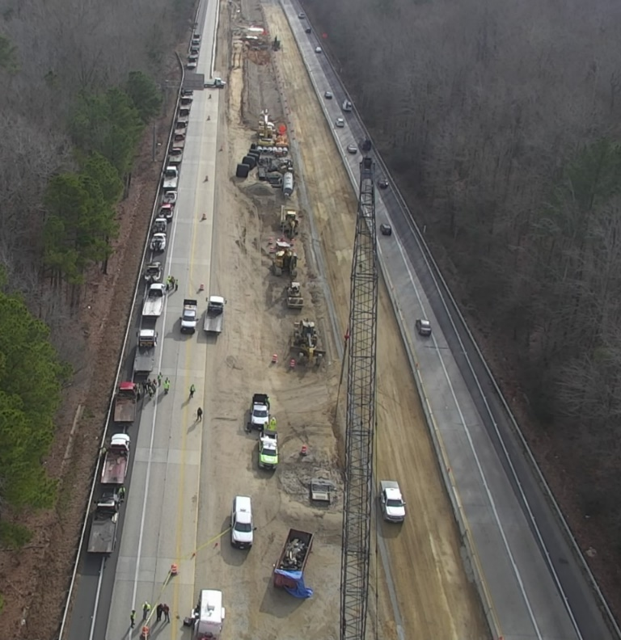
Commanding The Chaos Interstate 64 - Queens Creek Bridge
Positive Takeaways - continued
I-64 Construction Zone resources
Apparatus parking/staging
Porta-Johns on each end
Ability to clear the que

Slide 27
Commanding The Chaos Interstate 64 - Queens Creek Bridge
Areas of Improvement
Continue to develop and maintain relationships
Training
Pre-Plan for first arriving units
Backup to the pre-plan, may have to change plan completely (Weather/Construction/HazMat/Type of vehicles involved)

Slide 28
Commanding The Chaos Interstate 64 - Queens Creek Bridge
Summary
Date: Sunday, 12/22/2019
Multiple Vehicle Accident/MCI
75 Vehicles
4 critical patients (3 trapped)
47 Patients transported from scene
8 Self transport to area hospitals, SWRMC and RDH
55 Vehicles towed from scene

Slide 29
Commanding The Chaos Interstate 64 - Queens Creek Bridge
Summary – continued
Five working Incidents/Locations
Westbound @ mile-marker 238 (Queens Creek Bridge) – Injuries
Eastbound @ mile-marker 238 (Queens Creek Bridge) - Injuries
Eastbound @ mile-marker 238 (Queens Creek Bridge) – No Injuries
Westbound @ mile maker 242 (injuries) - Injuries
Westbound @ mile-maker 242 (injuries) – No Injuries

Slide 30
Commanding The Chaos Interstate 64 - Queens Creek Bridge
Summary – continued
Resources
16 Ambulances
3 MCI Buses
7 Fire & Rescue Departments
2 Law Enforcement Agencies
4 Hospitals (RRMC, RDH, SWRMC, VCU-MCV)
VSP, VDOT, VDEM, Tow Companies and Contractors

Slide 31
Commanding The Chaos Interstate 64 - Queens Creek Bridge
Thank You!
Stephen P. Kopczynski
Fire Chief/Coordinator of Emergency Management
York County, Virginia

