Slide 1
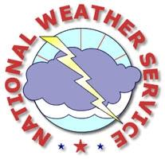
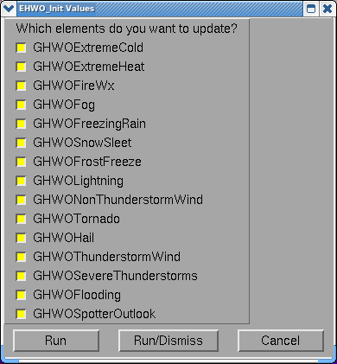
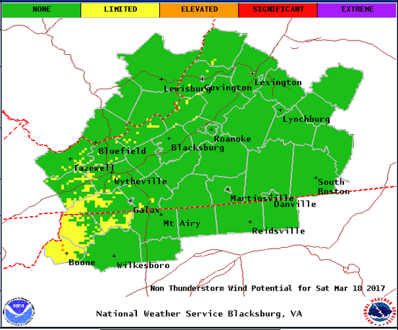
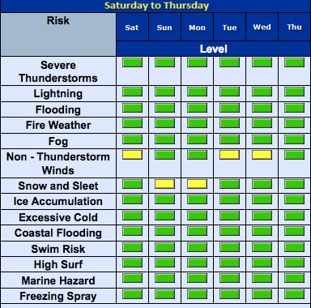
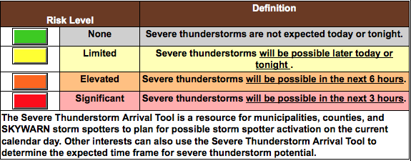
Experimental
Enhanced Hazardous Weather Outlook

Slide 2
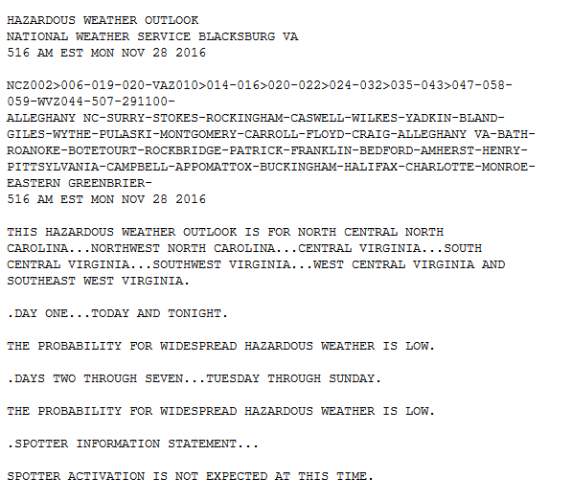
Enhanced Graphical HWO

Slide 3
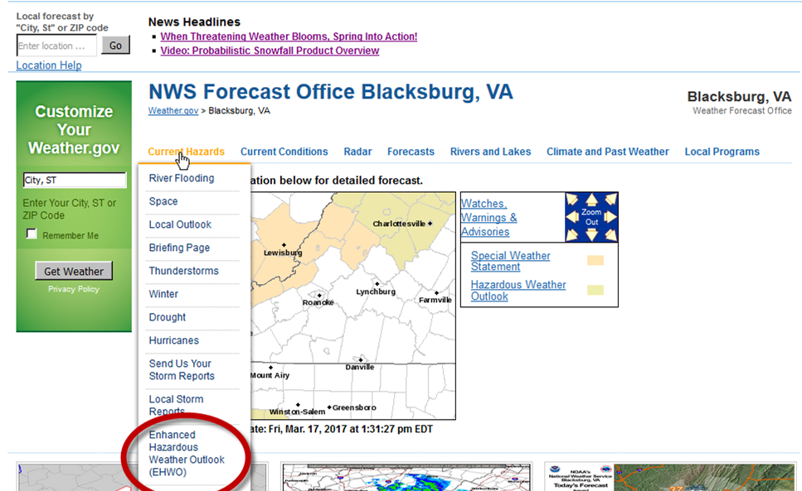
Enhanced Graphical HWO

Slide 4
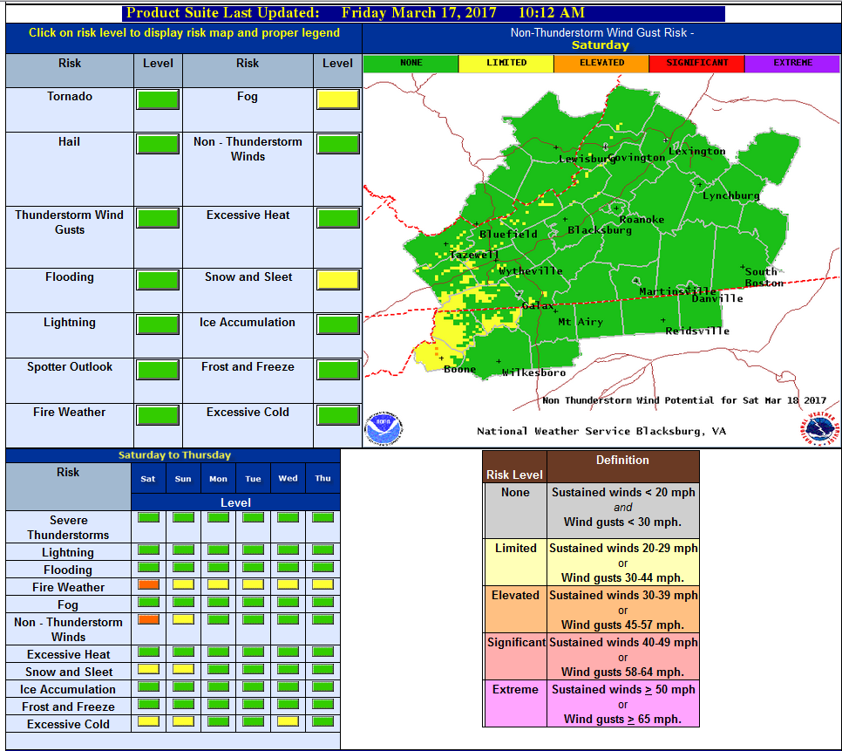
Enhanced Graphical HWO

Slide 5
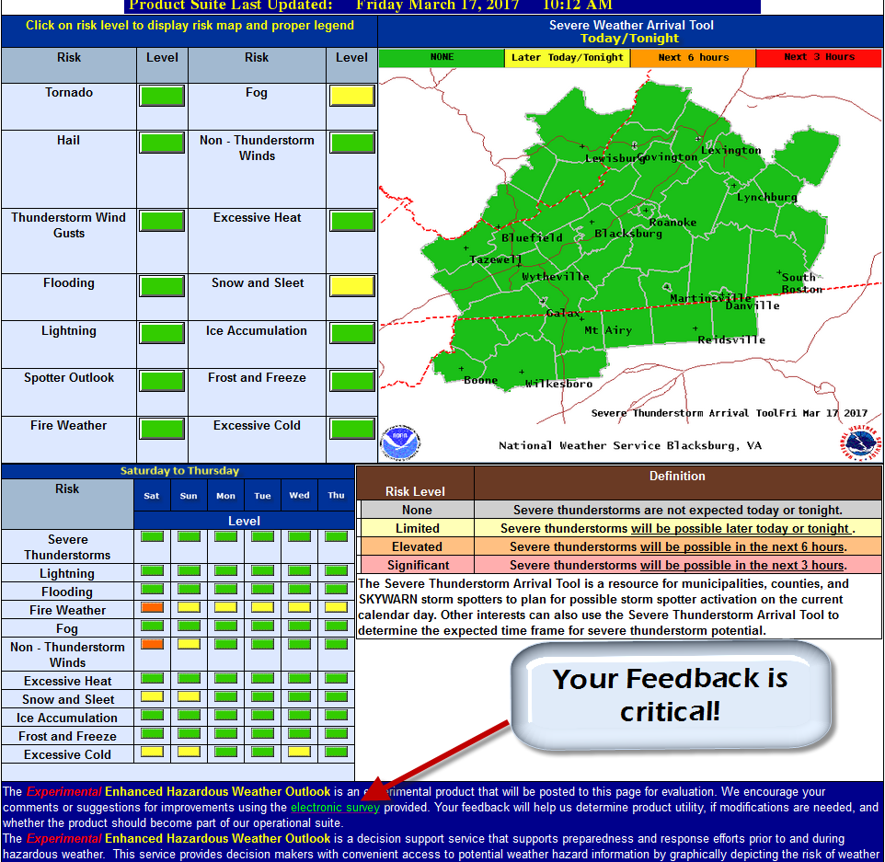
Enhanced Graphical HWO

Slide 6
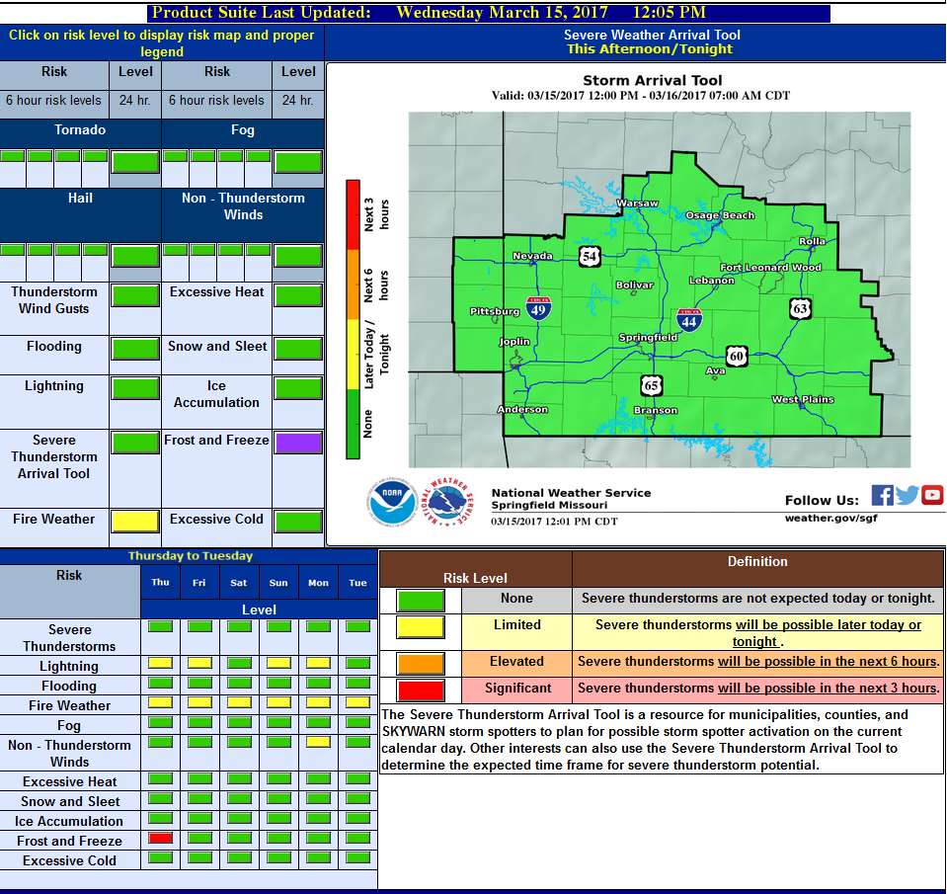
Enhanced Hazardous Weather Outlook
Version 2
http://www.weather.gov/sgf/ehwo_test2
Notes:
One big change with the new prototype is that it will no longer be generated from our local forecast database but, from a National forecast database.

Slide 7
Snowfall
Range of Possibilities
A real world example
Weather Forecast Office
weather.gov/rnk
@NWSBlacksburg
Blacksburg, VA

Slide 8
Communicating the Range of Snowfall Possibilities
Provides the “Goal Posts” of Snowfall Possibilities
Allows for Better Decisions
Leads to Less Impact on the Economy and Society

Slide 9
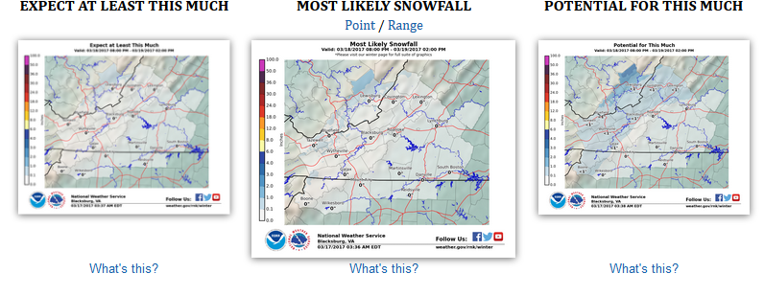
Snowfall Ranges: Potential Accumulation
The official NWS forecast
Current expectation, but often waivers with each update
Weather Forecast Office
weather.gov/rnk
@NWSBlacksburg
Blacksburg, VA
Notes:
The center image is the “most likely” snowfall. This is the official NWS Blacksburg forecast. This is what users should expect to receive from a forecasted winter storm. We recommend sharing this information on to the public if you field questions asking “how much snowfall will we get”. Clicking the Range or Point link will convert the image to either a selected point snow amount or a broader snowfall range.

Slide 10
Snowfall Ranges: Potential Accumulation
Sets the “floor”
You should plan on getting AT LEAST this much
Weather Forecast Office
weather.gov/rnk
@NWSBlacksburg
Blacksburg, VA
Notes:
The center image is the “most likely” snowfall. This is the official NWS Blacksburg forecast. This is what users should expect to receive from a forecasted winter storm. We recommend sharing this information on to the public if you field questions asking “how much snowfall will we get”. Clicking the Range or Point link will convert the image to either a selected point snow amount or a broader snowfall range.

Slide 11
Snowfall Ranges: Potential Accumulation
Sets the “ceiling”
Reasonable worst-case scenario
Weather Forecast Office
weather.gov/rnk
@NWSBlacksburg
Blacksburg, VA
Notes:
The center image is the “most likely” snowfall. This is the official NWS Blacksburg forecast. This is what users should expect to receive from a forecasted winter storm. We recommend sharing this information on to the public if you field questions asking “how much snowfall will we get”. Clicking the Range or Point link will convert the image to either a selected point snow amount or a broader snowfall range.

Slide 12
Snowfall Ranges: Potential Accumulation
80% + Accuracy
Weather Forecast Office
weather.gov/rnk
@NWSBlacksburg
Blacksburg, VA
Notes:
The center image is the “most likely” snowfall. This is the official NWS Blacksburg forecast. This is what users should expect to receive from a forecasted winter storm. We recommend sharing this information on to the public if you field questions asking “how much snowfall will we get”. Clicking the Range or Point link will convert the image to either a selected point snow amount or a broader snowfall range.

Slide 13
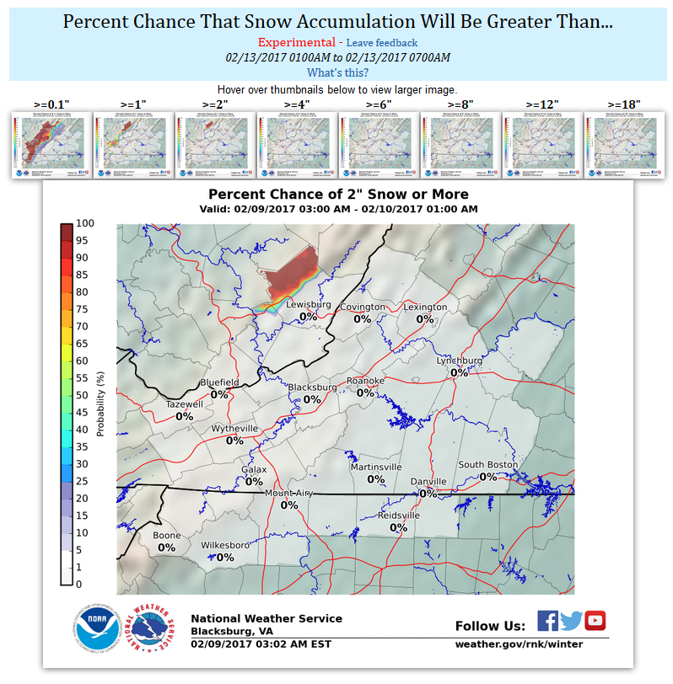
Snowfall Exceedance
Graphical Format
Weather Forecast Office
weather.gov/rnk
@NWSBlacksburg
Blacksburg, VA
Notes:
Another new product is snowfall exceedance probabilities. Put simply, this provides what the chance is of meeting or exceeding certain threshold snowfall amounts for various locations. First is a graphical format, which is a map of probability that shows the percent chance that snowfall amounts will be equal to or greater than particular values. Users can hover over the small thumbnailed images along the top row to change the graphic in the center for different thresholds. This information can be of value to those who need to make decisions based on the likelihood of meeting or exceeding threshold snowfall amounts (for example, what are the chances I see 4 inches or more of snow?”).

Slide 14
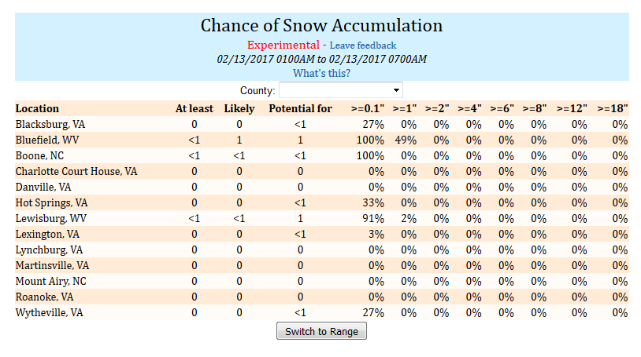
Snowfall Exceedance
Tabular Format
Weather Forecast Office
weather.gov/rnk
@NWSBlacksburg
Blacksburg, VA
Notes:
The same information is also available in a tabular format. A list of selected cities is provided as a default. However, by using the County pulldown, users will have access to this table for a wider range of cities and towns in a particular county. This can be useful for various county officials or schools. Provided in the leftmost column is the same “at least”, “potential for” and the official NWS forecast. Pressing the “Switch to Range” button will allow you to see snowfall ranges if that is preferred over point-based snow amounts.

Slide 15
What Science is Behind This?
69 Members Equally Weighted
25 Euro Members
1 Euro Op Run
1 Euro Ens Mean
26 SREF Members
10 GEFS Members
1 GEFS Ens Mean
1 GFS Op Run
1 NAM Op Run
1 Canadian Op Run 2 WRF Mesoscale
Provided From Ensemble*of Models
*Ensemble: Many different models of the atmosphere evaluated to show uncertainty/spread in forecast snow amounts

Slide 16
Range of Possibilities
Expect this much 90% chance you see at least
Potential for this much 10% chance for this much or more
Luray
Expect at least 3”, with a potential for as much as 13”

Slide 17
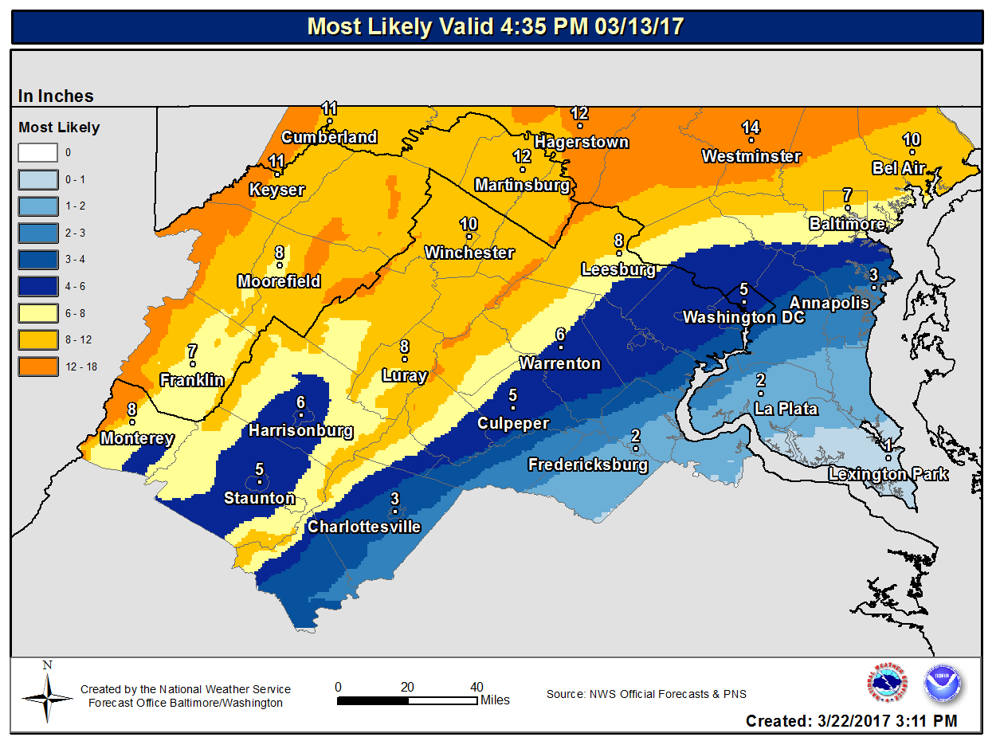
Most Likely (at this time)
Luray
Expect at least 3”, with a potential for as much as 13”
Current expectation is 8”

Slide 18
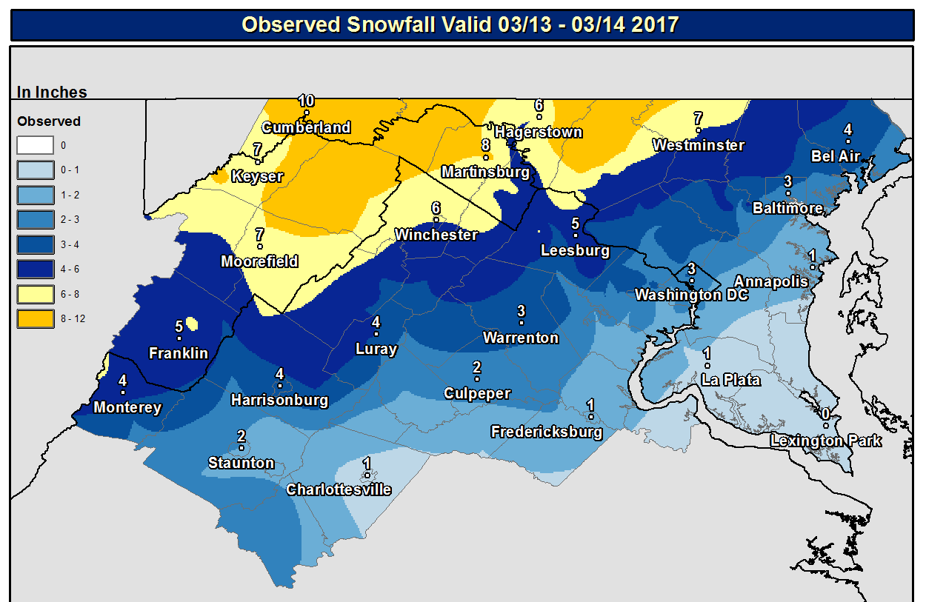
Range vs. Reality
In almost all locations accumulation fell within range

Slide 19
Using Range of Possibilities Enables Better Decisions

Slide 20
Discussion!

Slide 21
Conference Calls
What do you want?
Audio vs. Audio/Visual
Statewide vs. Regional
Frequency
Other
IDEALISM

Slide 22
Warnings
How do you get them into county ops 24/7 ?

Slide 23
Catastrophic Flood Potentials
https://www.youtube.com/watch?v=nrGBtQhAvo8
https://www.youtube.com/watch?v=Lo1nM0tv4Ds

Slide 24
Catastrophic Flood Potentials
Do you have catastrophic flood areas catalogued?
Not frequently flooded roads
Homes/communities, or popular recreation areas, that could be devastated (history?)
Could have significant loss of life in a 1:500 year rain/flood.
We need to know them!

Slide 25
Annual Tornado Drill
Successful for much of the state
Tech glitch @NWS Wakefield precluded issuance there
Report of Comcast tornado crawl without “test”
Other comments?

Slide 26
Frost / Freeze Warnings
Need to set dates soon, after which these would be issued
Date would likely be in April – May
Any resident experts?
Contacts can be sent to NWS offices.

Slide 27
What Else is on Your Mind?

