Slide 1
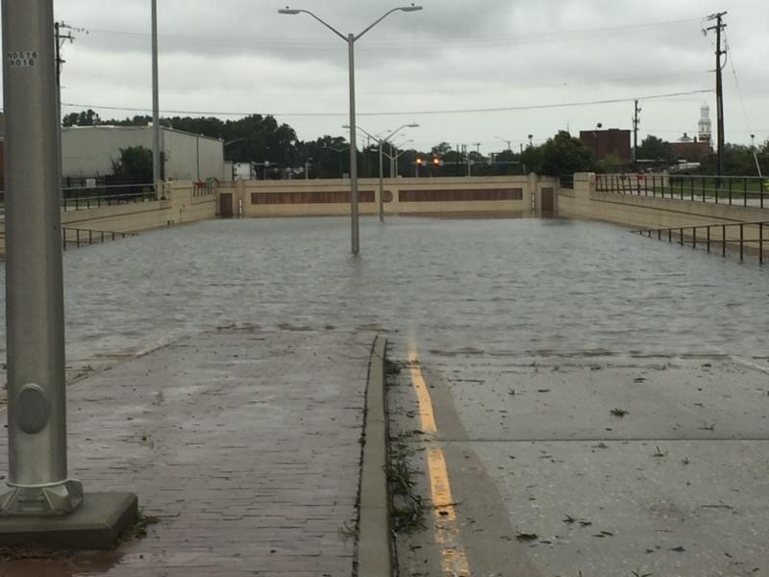
The STORM HAS PASSED… NOW WHAT???
Don Keldsen (FEMA)
Ed Porner (VDEM)
Erin Sutton (City of Virginia Beach EM)
Jim Redick (City of Norfolk EM)
Robb Braidwood (City of Chesapeake EM)

Slide 2
Disaster Declaration
Notes:
Requested by the Governor of Virginia on October 7, 2016
Declared on November 2, 2016
IA only at first
Amendment One signed on Nov. 16, 2016
Added additional IA and PA jurisdictions

Slide 3
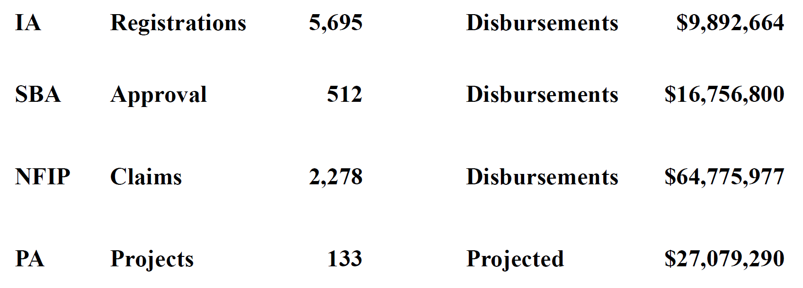
Matthew – By the Numbers

Slide 4
Agenda
Damage Assessment
IDA
PDA
Federal Assistance
Individual
Public
Disaster Recovery Centers
Disaster Survivor Assistance Teams
Public Messaging
Data
Lessons Learned

Slide 5
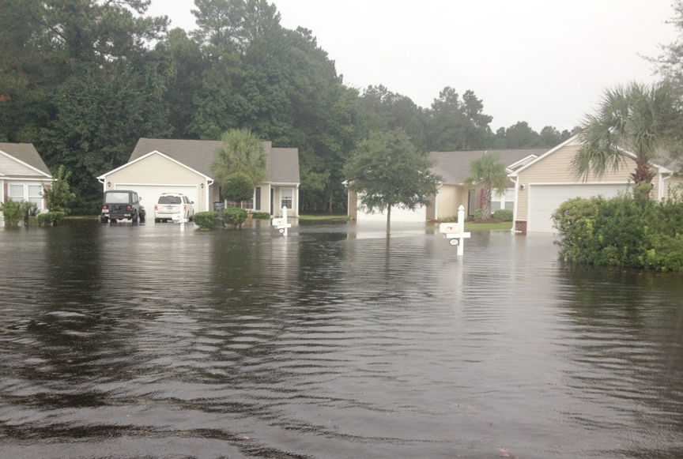
Initial Damage Assessment
Key Items
Local jurisdiction Internal issues
Crisis Track and Maps
State and Locals Timeline
State
Process
Challenges
Federal
Process
Challenges
Notes:
IDA verification team – not enough, logistics, kindergarten issues
The crazy FEMA form – “how many people don’t you know”
They took forever to get through neighborhoods – lots of hugs, don’t get out of the car – so what is this actually about?

Slide 6
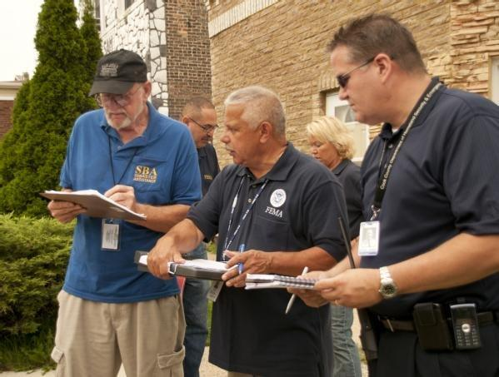
Preliminary Damage Assessment
Key Items
Local jurisdiction Internal issues
Crisis Track and Maps
State and Locals Timeline
State
Process
Challenges
Federal
Process
Challenges
PDA Narrative Report
Notes:
Purpose:
To provide a snapshot of disaster related damages.
To identify the impact, type, and extent of damages due to the disaster.
To respond to and evaluate the need for federal assistance.
To identify staff and funding needs.
To identify immediate needs of the individuals impacted.
There are 3 methods of performing PDAs:
Windshield Surveys (Drive By)
Door to Door (Walk By)
Flyover (Fly By)
Methods determined by the State and supported by FEMA and SBA.
Methods can be combined.

Slide 7
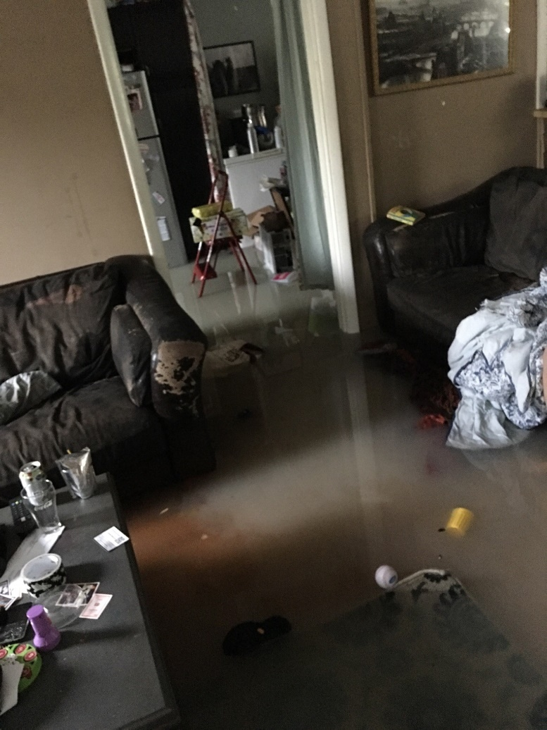
IA PDA Team Structure
Main PDA members include:
Local Government
State Government
SBA
FEMA PDA Specialist
Other members may include (as required):
External Affairs
Congressional Affairs
Disaster Survivor Assistance Teams
Voluntary Agency Liaison
Disability Integrations Specialist
Mitigation/EHP

Slide 8
Damage Assessment Matrix
Affected - Residences with minimal damage to the exterior and/or contents of the home
Any water line in the crawl space or basement when essential living space or mechanical components are not damaged or submerged.
Minor - Encompasses a wide range of damage that does not affect the structural integrity of the residence
Water line up to 18 inches in an essential living space
Damage to mechanical components

Slide 9
Damage Assessment Matrix
Major - A residence may be categorized as having major damage when it has sustained significant structural damage and requires extensive repairs
Water line above 18 inches in an essential living space, a water line above the electrical outlets, or a waterline on the first floor of a residence when basement is completely full
Destroyed -Residence is a total loss or damaged to such an extent that a repair is not feasible
Complete failure of two or more major structural components (e.g. collapse of basement walls, foundation, walls, or roof)

Slide 12
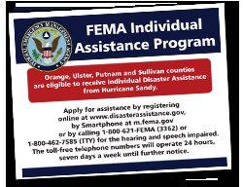
IA Program Overview
Financial Assistance.
Direct Assistance.
Additional IA Programs.
Voluntary Agency Coordination.
Disaster Recovery Centers.
Notes:
Rent, repair, replace, transient accommodations, personal property, transportation, funeral, dental, and medical.
Manufactured Housing Units, lease apartments, DHAP, multi family repair program.
Crisis Counseling, Disaster Unemployment Assistance, Disaster Legal Services, Disaster Case Management, Transitional Sheltering Assistance.

Slide 13
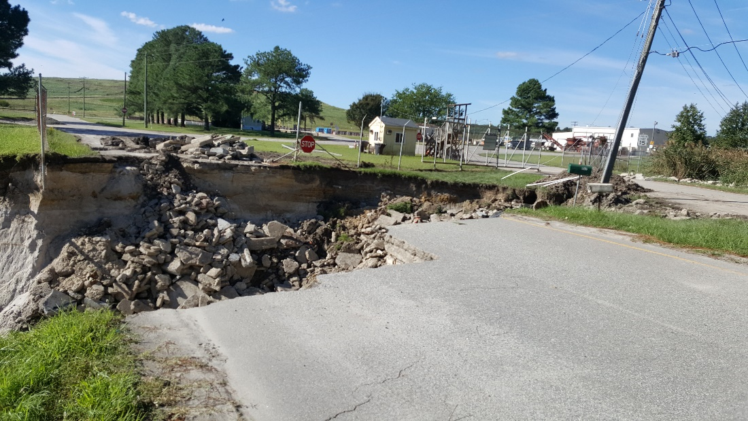
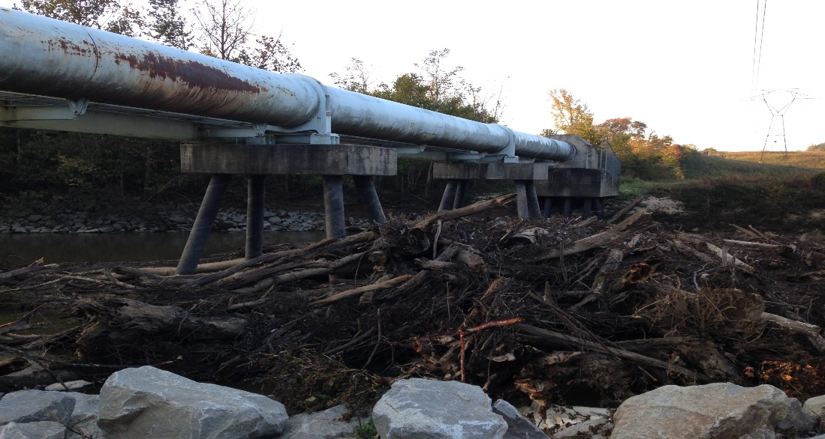
JOINT PDA - PA
Identifies, Describes and Reports:
Impact to public facilities and services
Dollars for repair
Special Considerations
How to Restore to Pre-event condition
Notes:
Review:
Magnitude to area
What, when, where, infrastructure
Severity
Impact on potential applicants
$ and unmet needs
work, repair, replacement, etc.
Using FEMA eligibility
-Restore to pre-disaster condition
- Special considerations

Slide 14
PUBLIC ASSISTANCE DECLARATION THRESHOLDS FY2017
Virginia
Impact Indicator $ 1.43 per capita
×
State Population (2010) 8,001,024
=
State Threshold $11,441,464.32
Individual County
Impact Indicator
$ 3.61 per capita
×
Accomack County
33,164
=
County Threshold
$119,722.04
Notes:
County/cities first
All entities which met threshold rolled up to state threshold
Was the state threshold met?
If not, but close what is impact?
What else needs to be considered.

Slide 15
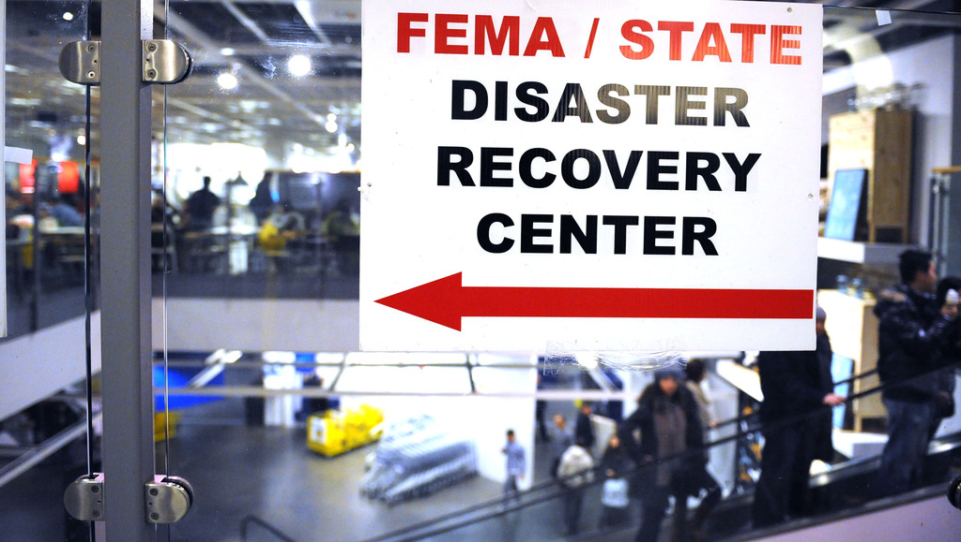
Disaster Recovery Centers
Square foot requirements
Proximity to affected population
Environmental and historical preservation
Equal rights and accessibility
Logistics
DIA
Security
IT
Safety Officer

Slide 16
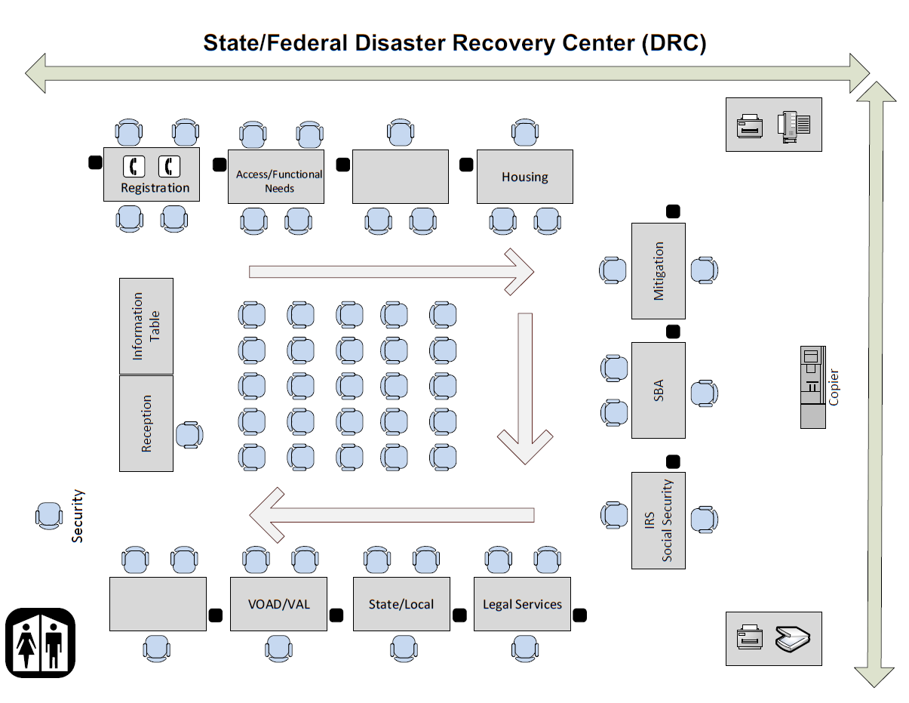

Slide 17
Disaster Support Assistance Teams (DSA)
Essential Functions of DSA
Assess, Inform and Report (AIR)
On-site Registration Intake
Case Status Updates and Inquiries
Survivor Needs Assessment
Referral to Whole Community Partners
Notes:
Unique asset to find underserved populations
Can be targeted at specific locations where communications are poor
Invaluable in getting information to support leadership and operational decision making
Catch-all for population not served by any other means

Slide 18
Our Message, their message, same message
Rumor Control
Stay in front of the message
The challenges with social media
Underserved populations, and how to reach them.
“Whole community” approach

Slide 19
Data, DATA Everywhere
What you need to know
Critical versus noise
Share and share alike (i.e. we always want more, but we’re unwilling to share it)
PII pitfalls

Slide 20
Questions?

