Slide 1

VDEM
Division Reviews
Virginia Emergency Management Symposium
March 22, 2017

Slide 2
VDEM Reorganization
Susan Mongold, Deputy, Mission Support

Slide 3
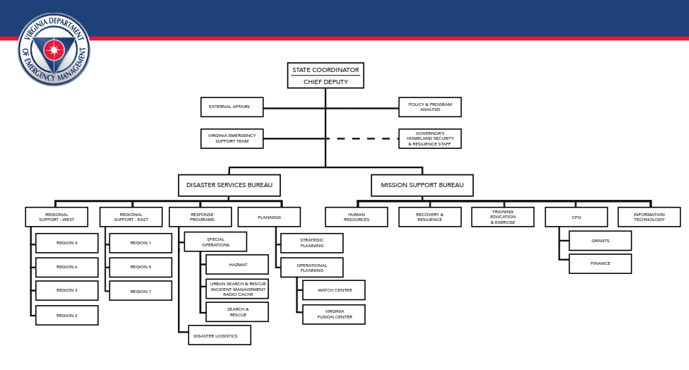
VDEM Organizational Chart

Slide 4
VEST Office
Michelle Oblinsky, VEST Director

Slide 5
VEST Office
Created as part of Reorganization
    VEST Director
    3 Full Time VEST Coordinators
Report to State Coordinator
Work with all Divisions in both Bureaus
All Full Time VDEM Employees have a role in VEST

Slide 6
VEST Office Responsibilities
Develop & Maintain Staffing / Roster
    Three Teams (A, B, C)
    VDEM staffs Key Positions on VEST Organizational Chart
    Other State Agencies fill ESF roles
    VEST not just Response, but also Recovery
      Recovery an Agency Mission, not a Division’s Mission

Slide 7
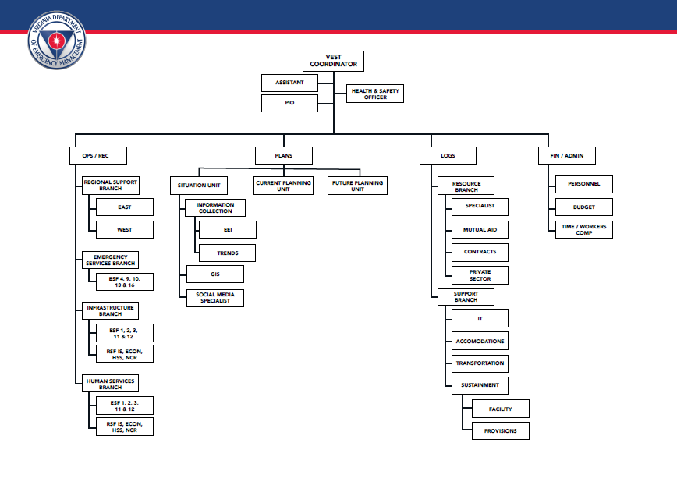
VEST Organization

Slide 8
VEST Office Responsibilities
General EOC Readiness
    Systems
    Equipment
Provide Guidance
    Develop Policies
Follow through on AAR Items / Corrective Action Plans
Training for VEST / state agencies

Slide 9
VEST Training
Training conducted Weekly, lead by VEST Office
Training Grouped by ICS Section
    Approximately 4 week rotation per group
Topics such as
    Task Books
    SOP / Check Lists
    New Processes
    WebEOC Boards
Sessions end with mini-exercises

Slide 10
Battle Rhythm
Planning / Meeting Cycle for EOC
    Command and General Staff meetings
    EEI / Reporting times
    Document Production times
      Dashboards
      Sit Reps
    Conference Calls

Slide 11
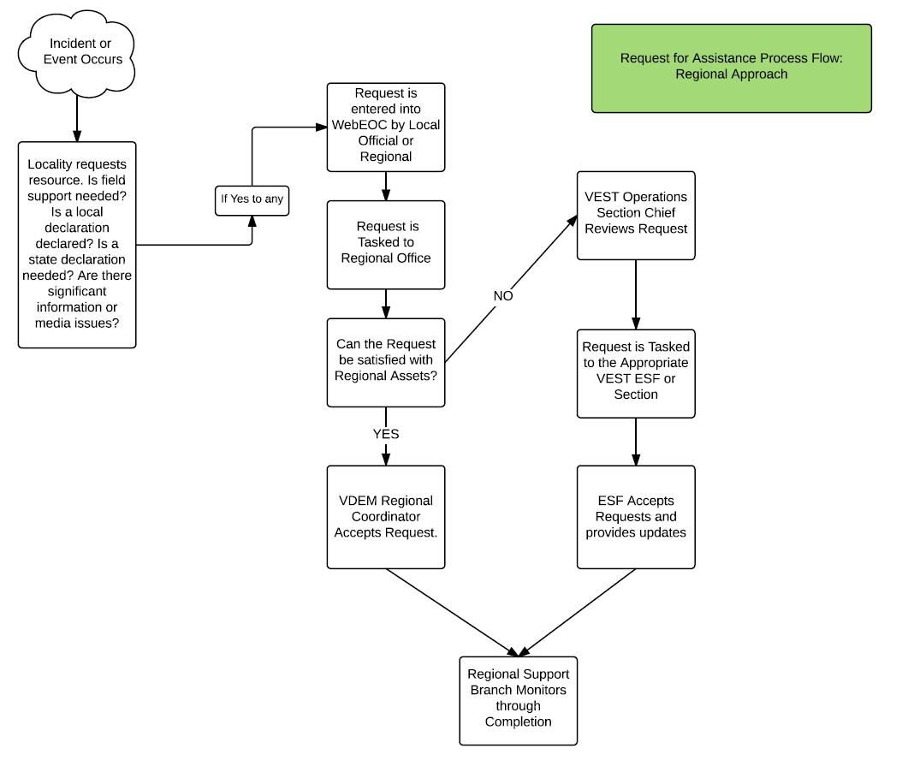
Request for Assistance Process Flow

Slide 12
Regional Support Branch Process Flow
Working with Regional Staff and OPS to fine tune
    Update of Request Management Process
    Localities requests vetted through regional office first; then through VEST
    Seamless to localities

Slide 13
Regional Offices
Jack King, Division East Director

Slide 14
Regional Staffing
Division East – Regions 1, 5, 7
Division West –Regions 2, 3, 4, 6
Regional Office Staff
    Chief Regional Coordinator
    Disaster Response and Recovery Officer
    Planner
    Hazardous Materials Officer

Slide 15
Grants Program
Richard Hazel, Grants

Slide 16
Questions?

