Slide 1
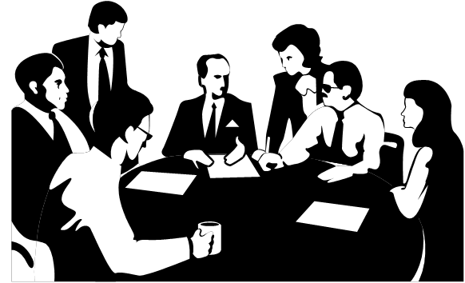

VDEM/VEMA Fall Forum 2016 David Farris
Committees: the good, the bad, and the ugly

Slide 2
You rarely see people going way above the norm. Do you?
If I am satisfied with my job I am more likely to be engaged and involved in committee work.
I think I actually did my fantasy football draft during [a committee meeting].
…yesterday I was in a meeting and I sat there and I said, ‘this is bullshit’, like completely tuning out because I feel that I have been treated unfairly.
I thought with a little bit of work and a little bit of redirection we could really make some progress so I pushed my way onto that group and so we’re doing some cool stuff there.
Although people probably don’t want to say I am doing this because I want to look good in front of my colleagues maybe that is it?
You rarely see people going way above the norm. Do you?
There is a difference between a meeting where people bring donuts and meetings that there is no donuts.

Slide 3



Agenda
What makes a committee unique
Why this issue warrants an hour of your time
Factors that influence committee performance
Getting the most out of committees
General discussion

Slide 4
What makes a committee unique?

Slide 5
task force: noun\ˈtask\ˈfȯrs\
a temporary grouping under one leader for the purpose of accomplishing a definite objective

Slide 6
team: noun \ˈtēm\
a group of people who work together
a group of two or more animals used to pull a wagon, cart, etc.

Slide 7
committee:noun com·mit·tee \kə-ˈmi-tē, sense 1 also ˌkä-mi-ˈtē\
a group of people who are chosen to do a particular job or to make decisions about something

Slide 8


Slide 10


Slide 11
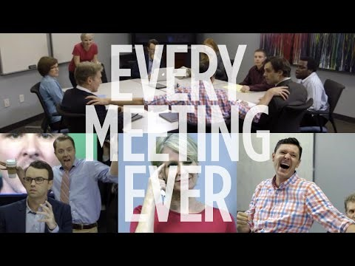

Slide 12
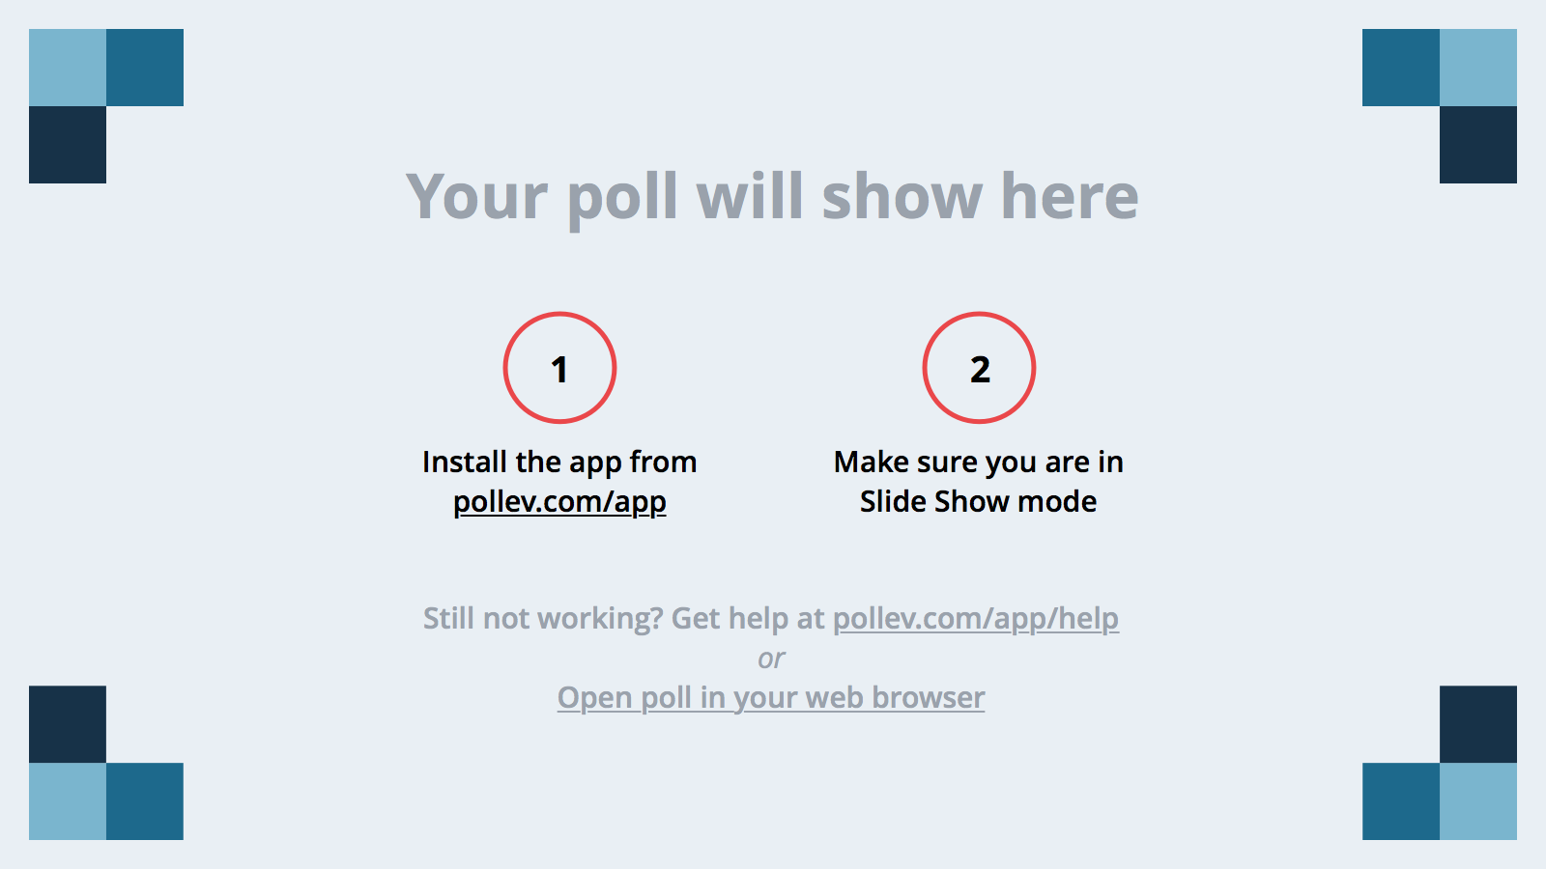

Slide 13
Why this issue warrants an hour of your time!

Slide 14

Why talk about committees?
We don’t and most us never will;
We abuse them and they are poorly conceptualized; and
All of us (insert: waste, dread, resent) time spent in committees to some degree.

Slide 15

The Business Case
x $$ x HOURS = $$$
x $$ x HOURS = $$$$

Slide 16

Professional Development
“You have people that never serve on a committee. Do they ever get promoted?... So if you are not willing to serve on a committee and put yourself out there and contribute you’re probably not going to get [promoted].”

Slide 17
Factors that influence committee performance

Slide 18
Committee Soup
Committee Composition
Committee Task/Objectives/Goals
Individual
Characteristics
Active Engagement
Compromise
Helping Behaviors
Group Dynamics
Leadership

Slide 19
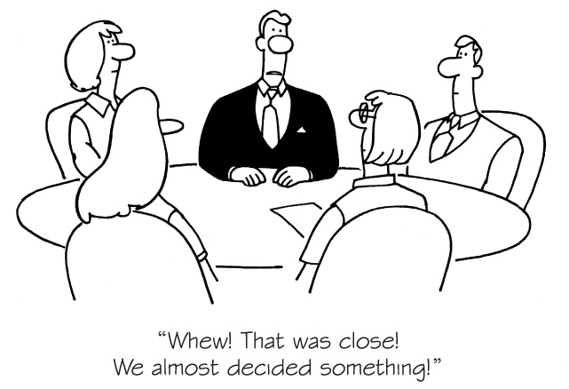
Why do we need a committee?
Only a committee can fix the issue
Free from political pressure
Clear goals and objectives
Committee Task/Objectives/Goals

Slide 20
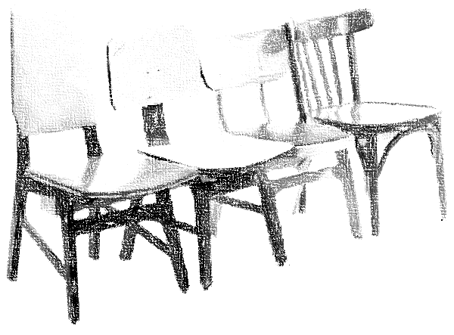
Committee Composition?
Size matters
Each member should be essential
Experience… (working in committees)
Hierarchy tends to discourage participation
Position may not be as important as personality
Happy employees make better committees members
Committee Composition

Slide 21
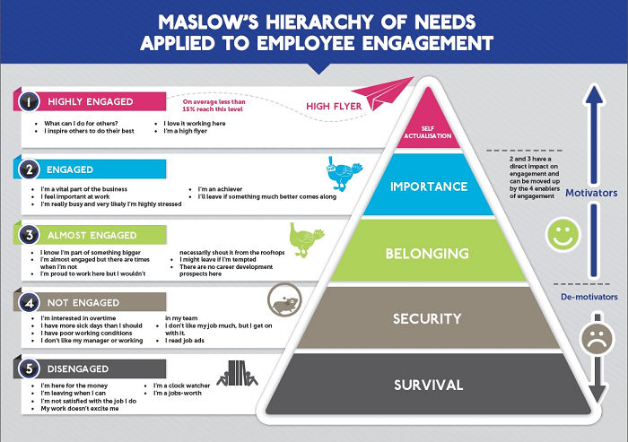

Slide 22
Who are we in committees?
Individual
Characteristics

Slide 23
Committee/Team Roles
Role | Definition
1. Resource Investigator | Researcher, looks for ideas, what have others done, reaches out to resources
2. Team worker | Worker, Jumps in and does the work, offers to help
3. Coordinator | ‘Leader’, formally or informally helps to direct individual efforts
4. Plant | Problem solver, thinks outside the box, comes up with ideas
5. Monitor Evaluator | Controller, keeps the groups efforts grounded and reasonable
6. Specialist | The SME, knows the topic and details
7. Shaper | Champion, motivates the group and helps to maintain momentum
8. Implementer | Planner, devises a way for the work of the group to be implemented/carried out
9. Finisher | Editor, finds gaps and errors and reveals weaknesses
Source: http://www.belbin.com/about/belbin-team-roles/

Slide 25
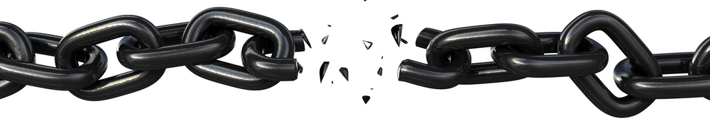
Group dynamics
Group Dynamics
Dysfunctional groups are…well…dysfunctional
One bad apple
Group inertia
Grandstanding
Mistrust
Committees require time to become functional groups

Slide 26
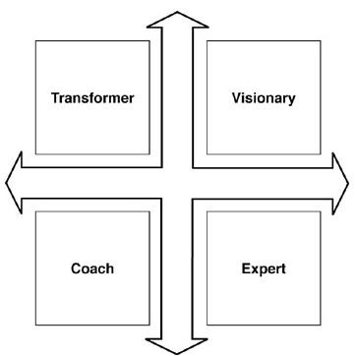
Leadership
Set expectations
Document action items
Hold committee members accountable
Address counter-productive behaviors
Leadership

Slide 27

How do we engineer committees to be successful
Planning
Structure
Management
Documentation
Meeting minutes
Action items
Leadership

Slide 28
Committee Planning = Project Management*
It’s a Committee IAP
Outlines the purpose
Identifies members
Serves as a project timeline
Tracks deliverables and action items
Reference sheet for committee
Initiate the team
Define or review scope
Develop process and roles
Monitor and control
Close out and review the project
Leadership
*A Guide to the Project Management Body of Knowledge (PMBOK Guide) Fourth Edition

Slide 29
Getting the most out of committees

Slide 30
And Then What?
Committee Composition
Committee Task/Objectives/Goals
Individual
Characteristics
Active Engagement
Compromise
Helping Behaviors
Group Dynamics
Leadership

Slide 31


Active Engagement
Compromise
Helping Behaviors

Slide 32
Active Engagement
Normative Committee Behavior | Active Engagement
Attend meetings (most of the time) | Prepare for committee meetings
Offer minimal contribution | Consistently contribute to the conversation
Avoid additional work/tasks | Collaborate with others
Unprepared for committee meetings | Take on tasks or volunteer for assignments
Distracted by personal devices or other work | Actively listen and express positive body language
Disinterested or disengaged | Complete assigned tasks on time
Non-responsive to requests for information | Continue conversations outside of the committee
 | Respect committee leadership

Slide 33

Compromise
“I try my best to see what is needed from my perspective and do that. I really try to meet the situation with the appropriate type of leadership or subordination as is required.”
“It’s not just about you, it’s not just about this particular group, its we’re doing this because we need to make sure that conditions are right for this group of people to do what they need to do and that’s what we’re going to focus on.”
Showing deference to other committee members;
Acknowledging a limited understanding or perspective of a subject;
Making concessions for the good of the group; and
Behaving in a manner that considers others perspectives.

Slide 34

Helping Behaviors
Lend assistance on a project;
Provide unsolicited information;
Come to another persons defense;
Help someone navigate politics; and
Resolve conflict in the committee.
“I have colleagues that I know have strengths and weaknesses, and if they sign on to do something that I know they are motivated to do, but they may have some weakness, and I know that I can supplement them if we work well together, I would be happy to help and have done that.”

Slide 35
Wrapping up

Slide 36
Committee Composition
Committee Task/Objectives/Goals
Individual
Characteristics
Group Dynamics
Leadership

Slide 37
Individual
Satisfied
Conscientious
Interested
Committee
SMART goals
Autonomous
Composition
Right people
Flat organization
Group Dynamics
Familiarity
Trust
Leadership
Plan committees
Set expectations
Actively manage

Slide 39

Closing
What are your professional and personal interests?
What is your motive for engaging in the committee’s work?
How can you use committee work to advance yourself or others?
What kind of impression do you want to leave with your colleagues?
How can you create more productive/efficient/worthwhile committees?

Slide 40

Questions and Discussion David Farris, Ph.D., MBA, CEM Executive Director of Safety and Emergency Management George Mason University dfarris@gmu.edu O: 703-993-2507 C: 571-233-0000

