Slide 1


Emergency Management Response to the
Pulse Nightclub Shooting
April Taylor, FPEM
City of Orlando
Office of Emergency Management
Notes:
Emergency Management Perspective and our roles in support of the incident

Slide 2
Discussion Outline
Community Setting
Previous Active Shooter Training
The Pulse Incident
EOC Activation
Assistance Centers
Community Response
  Beyond First Responders
Key Observations
Notes:
Things that we observed and learned

Slide 3
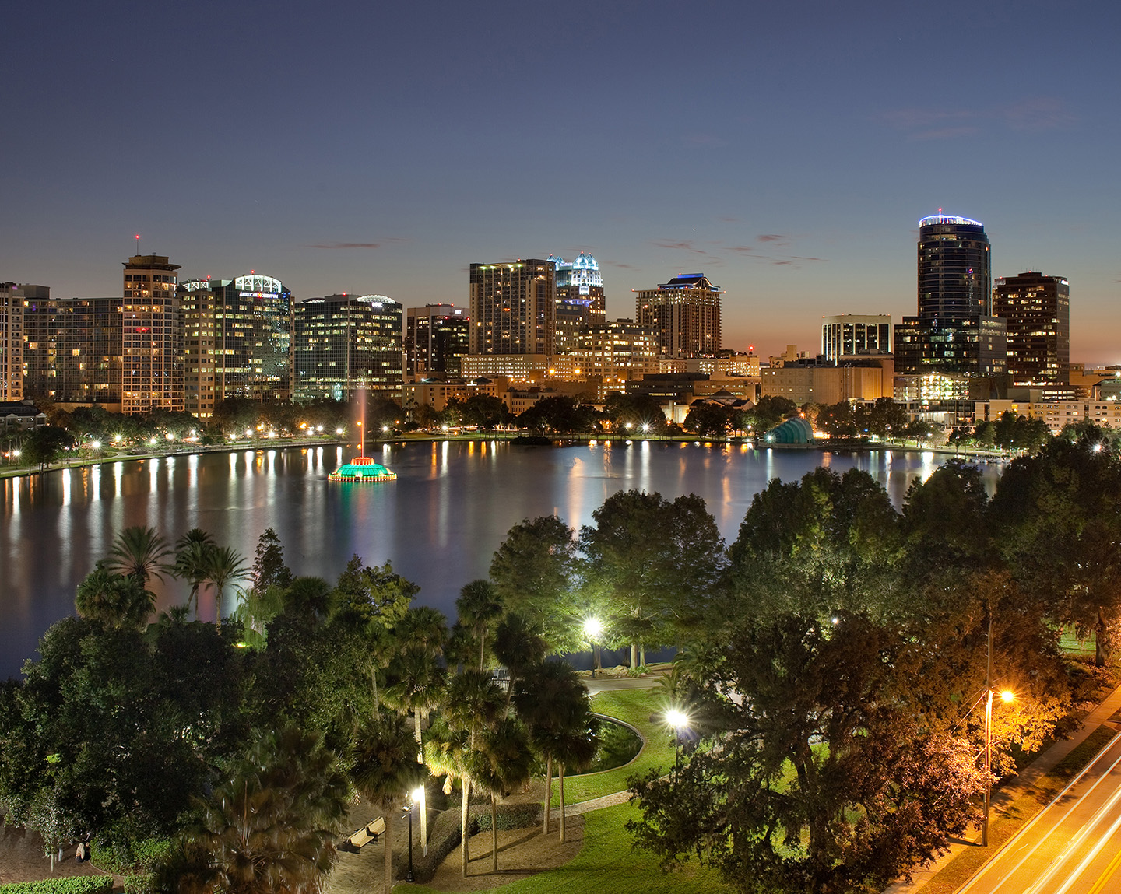


  “One of America’s ten coolest cities, citing Orlando’s number of night life, cultural and recreational outlets” Forbes Magazine
  Strong Mayor form of government
3,300 employees/$1.2 billion annual budget
265,000 annual residents (28% Hispanic and 27% Black)
Forbes ranked Orlando 35th on their list of America’s safest cities
Notes:
Orlando International Airport visitors – over 60 million annually
Disney
Universal Studios
SeaWorld
MLS Soccer
Magic Basketball
2nd Largest University
Our economy depends on tourism
Strong commitment to public safety from Mayor and city leadership

Slide 4
Pre-Pulse Training
Implemented Mass Casualty Incident (MCI) training with Orlando Police Department (OPD), Orange County Sheriffs Office (OCSO) and FBI as early as 2005
2013 - St. James School (OPD/OFD/OCSO/OCFRD)
2014 - Edgewater High School Active Shooter
2015 - Active Shooter/EOD exercise with local area SWAT teams coordinated by FBI at The Mall at Millenia
2015 - Annual Tabletop Exercise on Civil Disobedience
2015 - Conducted a Down Aircraft Full Scale Exercise
2015 - University of Central Florida Full Scale Exercise
2015 - Valencia College, West Campus Full Scale Exercise
Notes:
LE/Fire train together
Regional Exercises
Annual EOC TTX Training at Executive Level and our ESFs

Slide 5

June 12, 2016
Notes:
Just after 2am on Sunday morning
The night before Christina Grimmie was shot and killed, that gunman took his own life

Slide 6
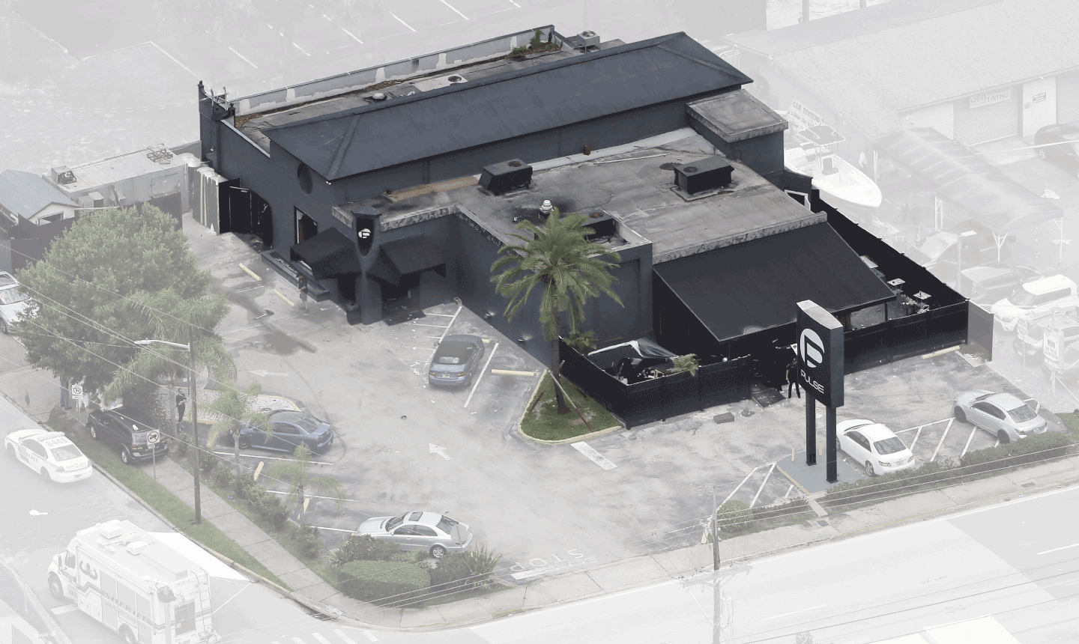
XXX
N
Building: Nightclub
Built: 1957
Floors: 2 Story
Gross Area: 4853 sq. ft.
Exterior Walls: Concrete Block Stucco
Weather: Clear, 77 F, with no wind at 85% humidity
Time of Incident: 2:02 a.m. first call received
Occupants: Approximately 300 at time of incident
Notes:
Previous use was an Italian restaurant
The week after the Pulse incident was one of our hottest weeks all summer 95F+ everyday with no rain
Point out side of breeched wall and gunman van location

Slide 7
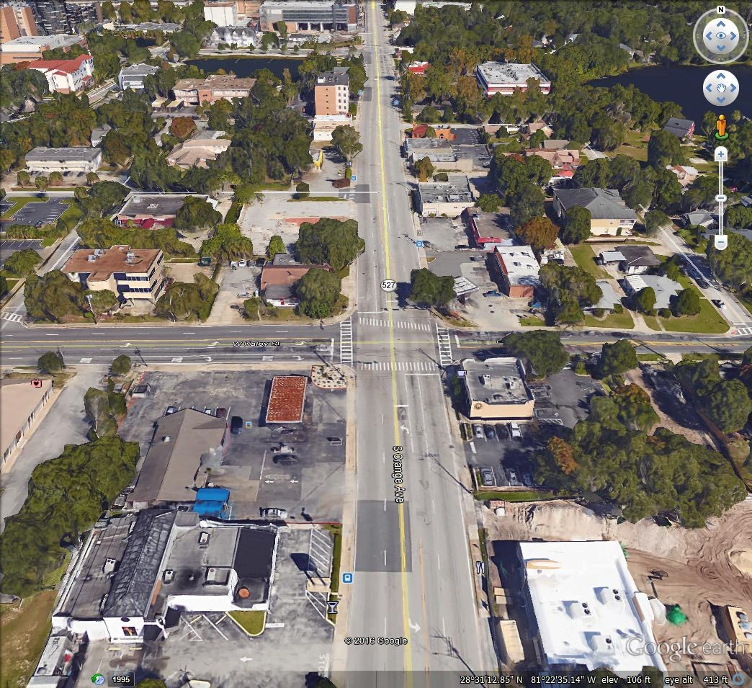

ORMC
OFD
Station 5
Pulse
Nightclub
Notes:
Note the proximity of ORMC and Station 5 to the nightclub

Slide 8





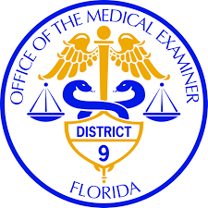


Initial Responding Agencies (within 6 hours of event)
Orlando Police Department, Orange County Sheriff and Multiple Police Agencies
Orlando and Orange County Fire Departments
Orlando Fire Dept. Arson/Bomb Squad
Rural Metro (transport for Orlando)
OPD SWAT
Multiple Hospitals
Orange County Medical Examiner
Florida Department of Law Enforcement
Florida Highway Patrol
Central Florida Intelligence Exchange
Federal Bureau of Investigation
Bureau of Alcohol ,Tobacco, Firearms, and Explosives
Drug Enforcement Administration
Department of Homeland Security
Notes:
CFIX – Fusion Center

Slide 9

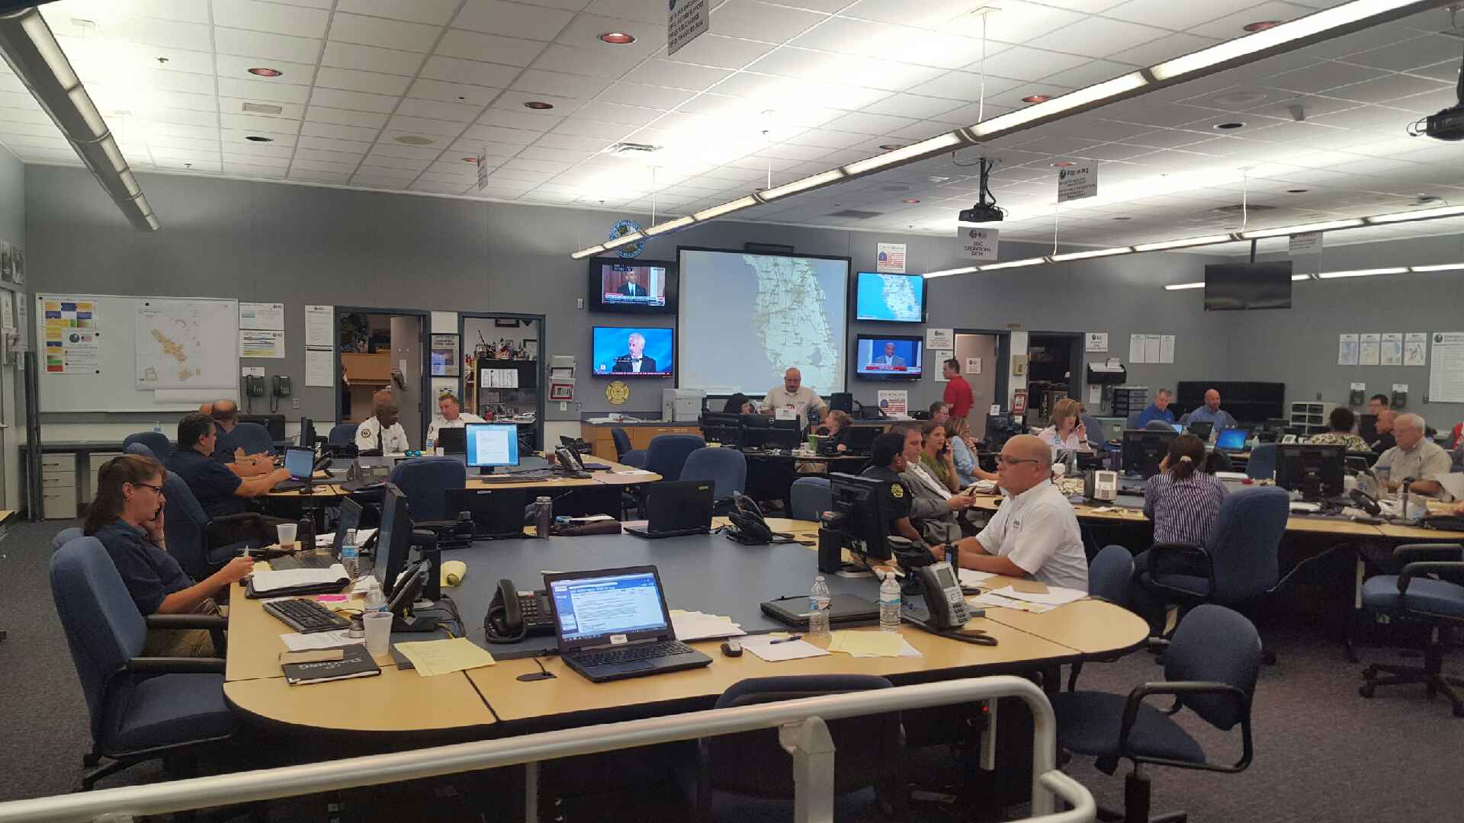
Emergency Operations Center
Activated to a Level 1 (June 12, 2016 - June 22, 2016)
Mission was to provide Operational Coordination and Support for the following:
OPD Command Post and On-scene Operations
Establish the Emergency Information Center (EIC) / Help Line
Dignitary Visits, Funerals, Memorial Services, and Vigils
Family Reunification Center
Family Assistance Center
Orlando United
Assistance Center
OneOrlando Fund
Notes:
Approximately 3am – Manny was notified
0844 – official EOC activation

Slide 10

Emergency Management Team
City of Orlando
ESF-01 Transportation
ESF-02 Technology Management
ESF-03 Public Works
ESF-04 Fire Service
ESF-5 Emergency Management
ESF-6 Families, Parks, & Recreation
ESF-7 Procurement
ESF-14 Public Information
ESF-15 Volunteers & Donations
ESF-16 Law Enforcement
ESF-18 Economic Development
ESF-19 Damage Assessment
Executive Offices
Chief Administration Offices
Partner Agencies
Orange County Office of Emergency Management
Seminole County Office of Emergency Management
Osceola Office of Emergency Management
Lake County Office of Emergency Management
State of Florida Division of Emergency Management
LYNX
Federal Bureau of Investigation
Department of Justice
Department of Veteran Affairs
Department of Homeland Security
British Consulate
Notes:
Local, State, Federal, and International

Slide 11

Social Media/Website
Initially used OPD Twitter account
Transitioned into the City and Mayor Facebook and Twitter accounts
Link off of City’s homepage
  Pulse update page
Most information disseminated in English and Spanish
In the month that followed:
Twitter | City of Orlando Account | Mayor Dyer Account
Tweets | 190 | 145
Impressions | 3.8 million | 3.8 million
Link Clicks | 19,200 | 9,100
New Followers | 7,877 | 3,909
Facebook | City of Orlando Account | Mayor Dyer Account
Posts | 159 | 119
Impressions | 2.6 million | 1.8 million
Link Clicks | 23,919 | 7,023
New Followers | 8,340 | 4,549
Notes:
City was still open for business
Could not take over homepage like we do for Hurricane events
17 Press Releases
12 “City News” posts
11 Mayor updates
80 unique graphics for Social Media
6:30 hours of video
14 videos
5316 photos

Slide 12
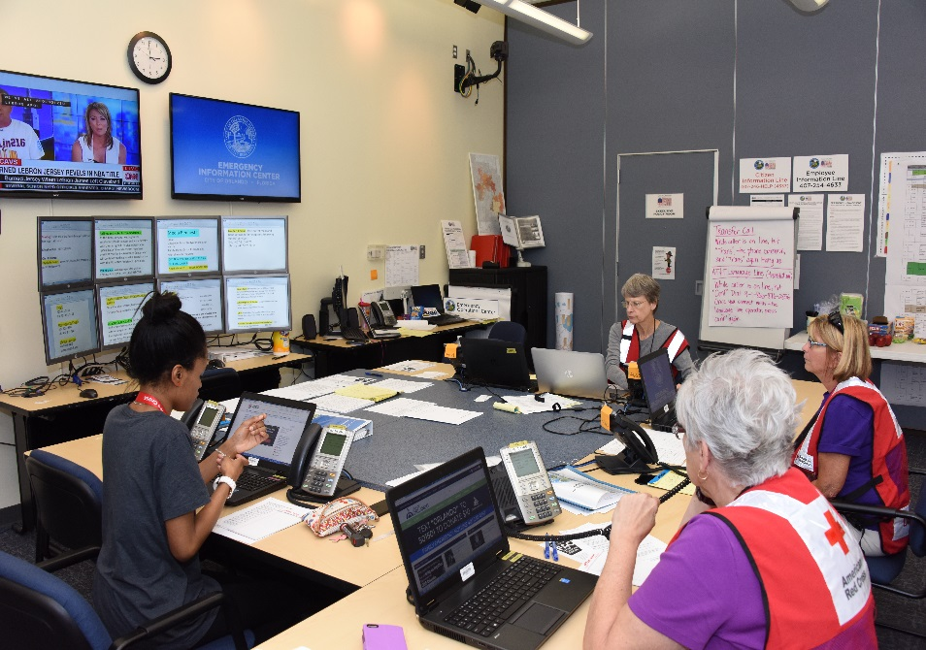
Emergency Information Center
Activated to a Level 1 (June 12, 2016 - June 22, 2016)
Mission : Provide information to family and friends of victims. It also served as the Victim Information Center for FEMORS.
Staffed by Community Service Officers, City Staff and City Volunteers, and the American Red Cross
Started with a phone bank
of 12 phones
  Expanded to 23 phones
  Received over 6800 calls
Notes:
10am – 407-246-HELP
Within 15mins the 12 lines were overwhelmed and expanded to 23 phone lines
Operated 24 hours a day
Normal call center staff takes calls following a hurricane/TS, not prepared for the Crisis calls
OPD CSOs were the original call takers
Using intake forms

Slide 13
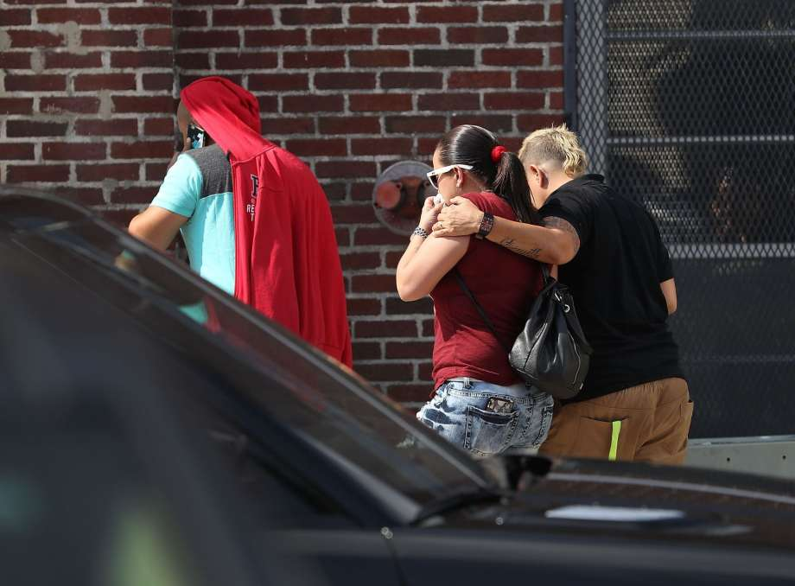
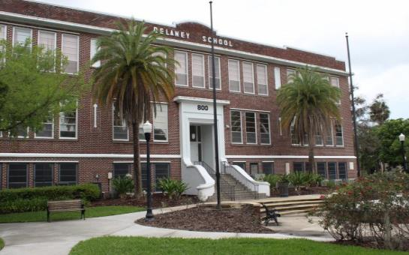
Family Reunification Center
Beardall Senior Center
June 12, 2016 - June 14, 2016
Established for the Notification of Next of Kin and Victims Identification
FBI Crisis Team, FEMORS, and FDLE
Notes:
ORMC emergency room
Hampton Inn
Hospital EM called Orlando OEM for help
FRC opened at 3pm on Sunday
Closed about 9pm on Tuesday evening
Biggest issues were security and media
Parking

Slide 14
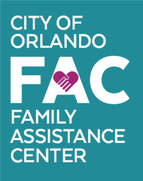
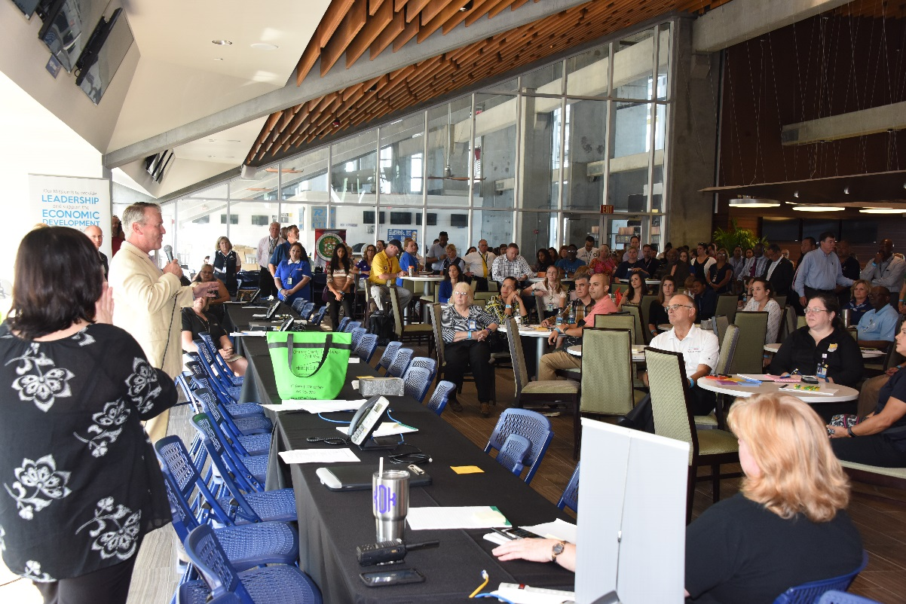
Family Assistance Center
Camping World Stadium
June 15, 2016 - June 22, 2016
Established to support the immediate needs of families, friends, and victims
Services Provided
Air Travel/Lodging
Animal Services
Child And Family Services
Consulate Services
Counseling/Spiritual Care
Crime Victim Services
Funeral Services
Health Care Assistance
Identification Documents
Legal Aid
Medical Examiner
Notes:
Press conference at 8am
FAC opened at 10am
Over 40 agencies represented
Language – Spanish speakers
Foreign Consulates
Office of Foreign Missions

Slide 15
Agencies Represented at FAC
African-American Chamber
American Airlines
American Red Cross
Aspire Health
Attorney General’s Office
Catholic Charities
Caribbean American Chamber
Children’s Home Society
Colombia Consulate
Delta Airlines
FBI
Fl Crisis Response Team
Fl Dept of Children and Family
Fl Dept of Vital Statistics
Fl Morticians Assoc
Govt. of Puerto Rico
Greater Orlando Aviation Authority
Heart of Florida United Way
Hispanic Chamber of Commerce
Howard Phillips Center for Children and Family
JetBlue
Legal Aid Society
LGBT Chamber of Commerce
LGBT Community Center
Lynx
Medical Examiner’s Office
Mexican Consulate
OCSO Victim Advocate
Orlando Utility Commission
Osceola County
Florida Morticians Assoc
Pet Alliance
Salvation Army
Senior Resource Alliance
Social Security Administration
Southwest Airlines
Therapy Dogs International
Tax Collector
United Airlines
US Veteran Affairs
Zebra Coalition

Slide 16
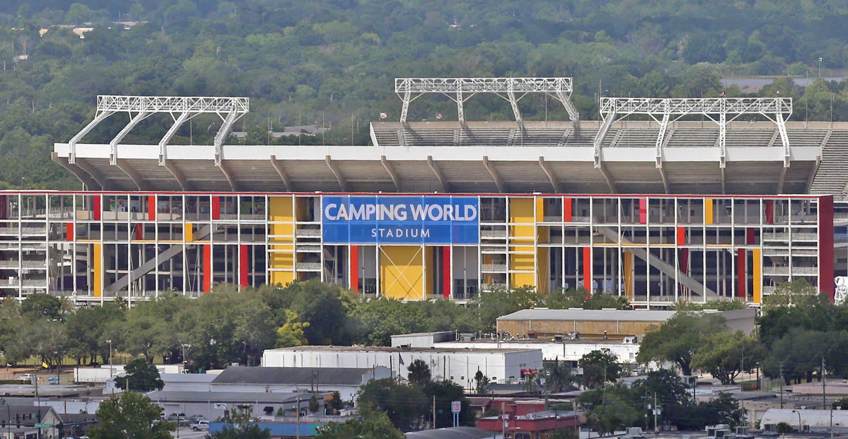
Family Assistance Center
Camping World Stadium was able to provide:
Space (Office, Admin, and Support)
Security and Parking Staff
Logistical Support
Secure Parking Area
Designated Media Area
Camping World Stadium Layout:
1st Floor Registration
2nd Floor Family Assistance Center
3rd Floor JSOC and Personal Items/Effects
Notes:
Ample parking
Ability to control access

Slide 17
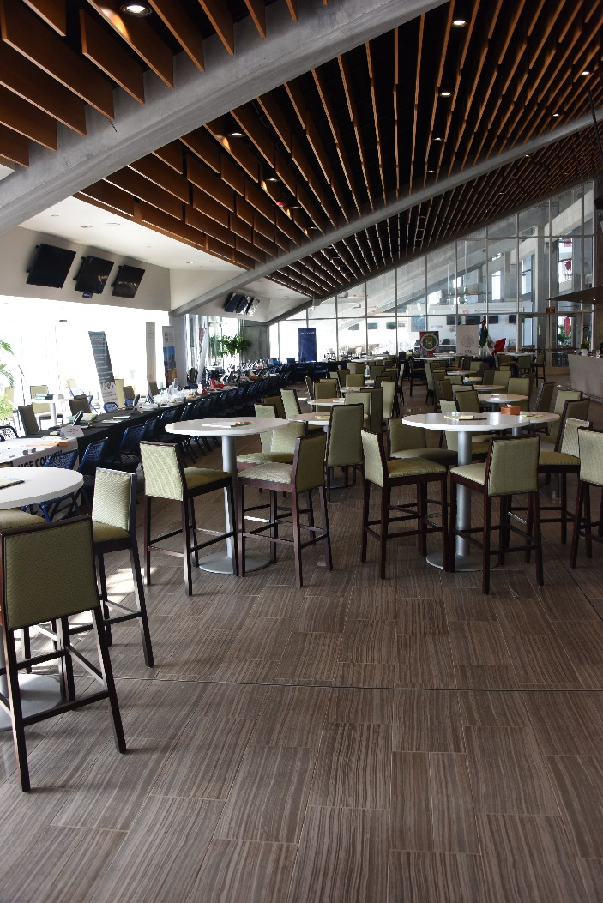
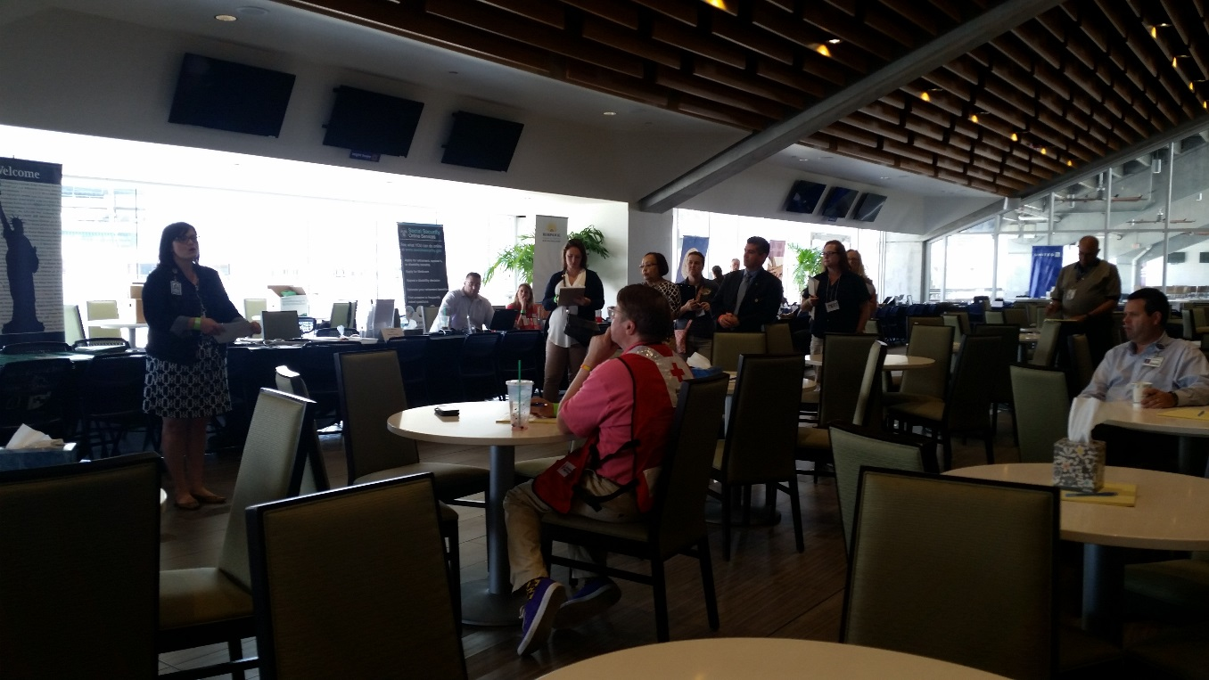
Family Assistance Center
Served over:
900 Individuals
255 Families
Notes:
Many families and/or victims made more than one visit

Slide 18

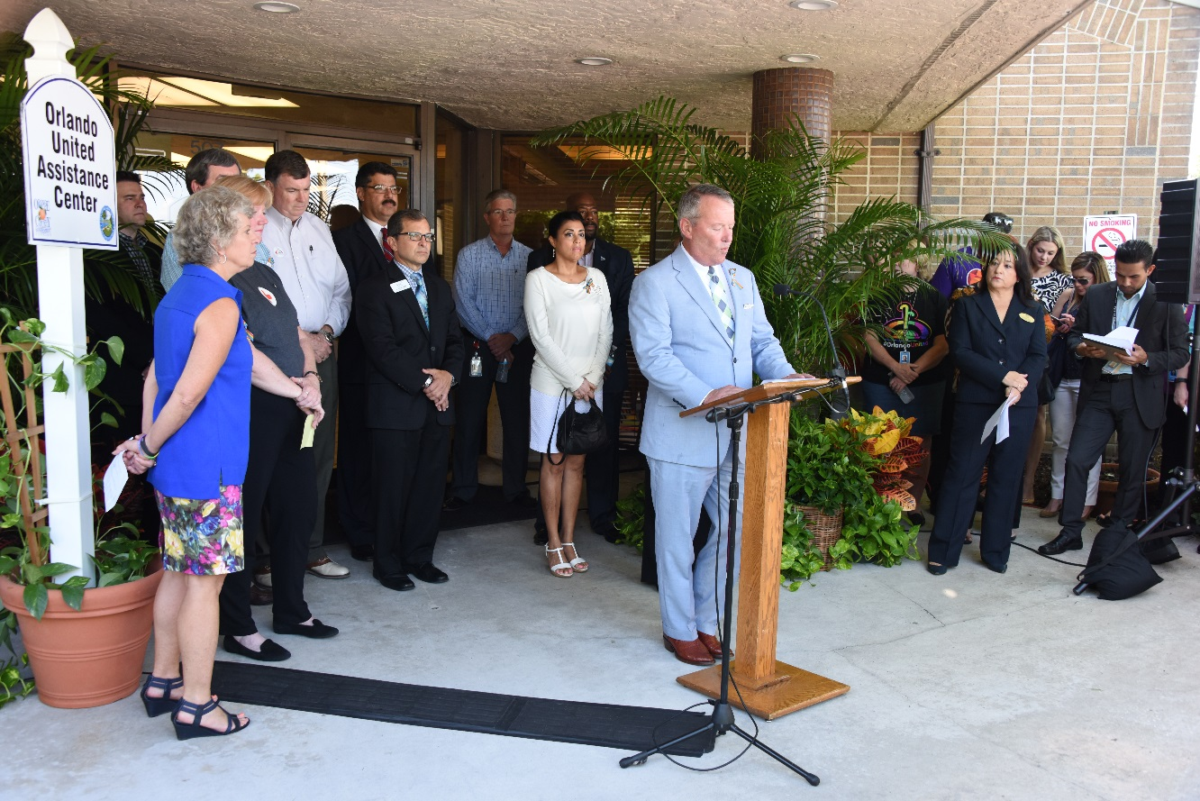
Orlando United Assistance Center
Michigan Street in South Orlando
June 23, 2016 - current
Partnership between the City of Orlando, Orange County Government and the United Way
Serves as a navigation point to assess the needs and provide information, support and resources to those directly affected
Services Provided:
Long-term Support
Family Services
Mental Health Services
Counseling
http://www.cityoforlando.net/hope/

Slide 19
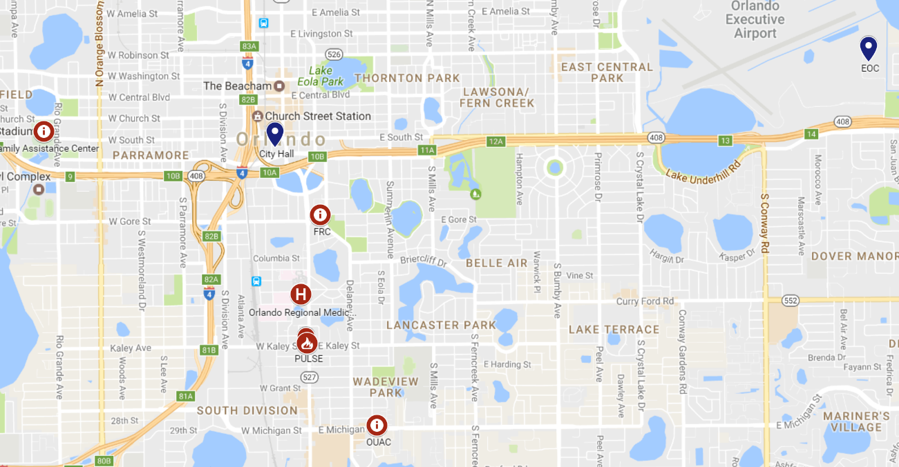
Orlando Area Map
Fire Station #5
PULSE

Slide 20
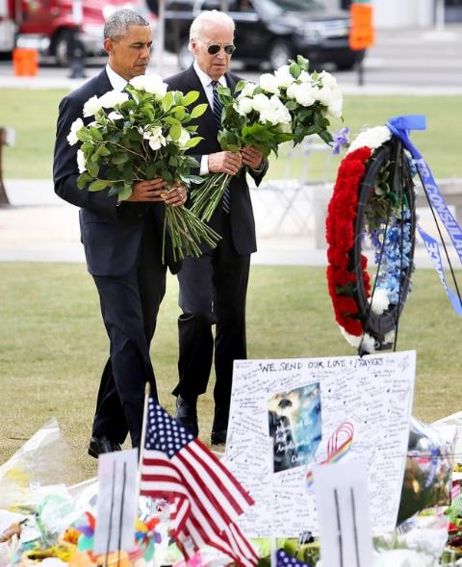
Political Leader and Dignitary Visits
President Barack Obama
Vice President Joe Biden
City Mayor Buddy Dyer
County Mayor Teresa Jacobs
State Governor Rick Scott
Senators Bill Nelson, Marco Rubio,
and John Mica
Congresswoman Corrine Brown and Congressman Alan Grayson
State Attorney General Pam Bondi
Attorney General of the United States Loretta Lynch
FBI Director James Comey
Former Secretary of State Hillary Clinton
Notes:
Learned that we needed dedicated liaisons to escort VIPs

Slide 21
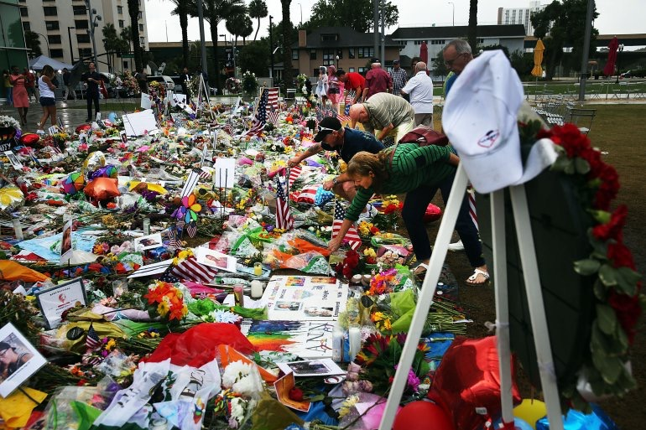
Dr. Phillips Lawn Memorial Site
Notes:
Orange County Regional History Center is cataloging items
Flowers being composted
Dr. Phillips lawn was the official memorial site

Slide 22
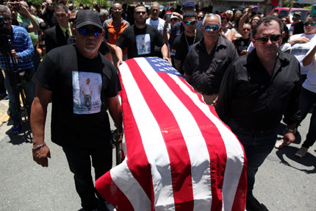
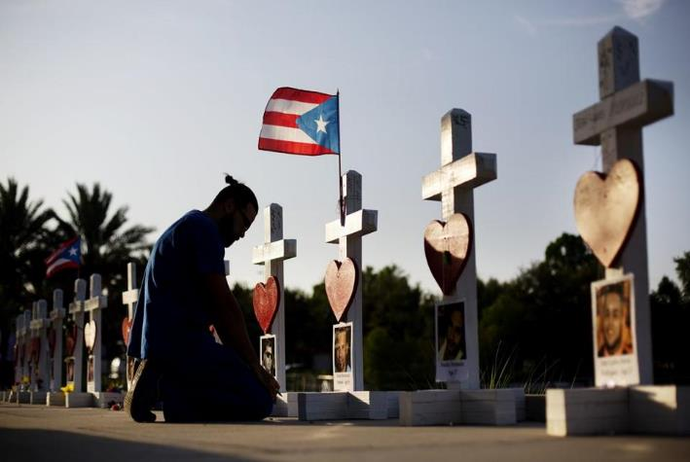

  Memorial Services and Vigils
Notes:
Several fatalities were transported out of country
These crosses were set up by a private citizen at ORMC, History Center ended up collecting them

Slide 23
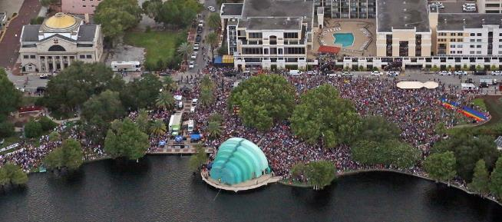
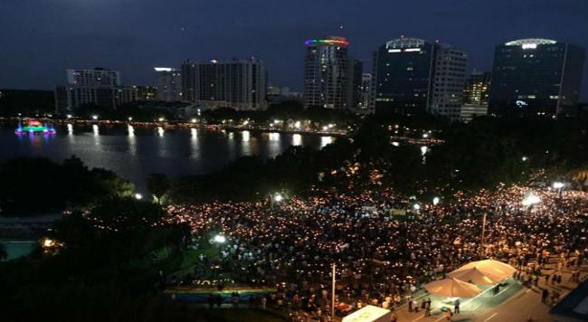
  Memorial Services and Vigils
Notes:
A lot of the memorials/vigils were organized organically through FB and Social Media
This vigil at Lake Eola drew a crowd of more than 50,000 people – EOC assisted with monitoring the event, LE and Fire onsite, traffic management, transportation by Lynx from various locations around city to help with parking issues downtown

Slide 24
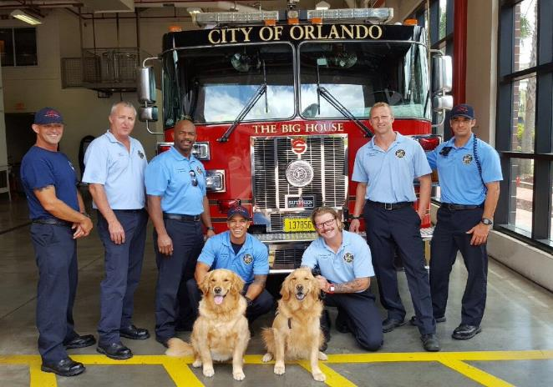
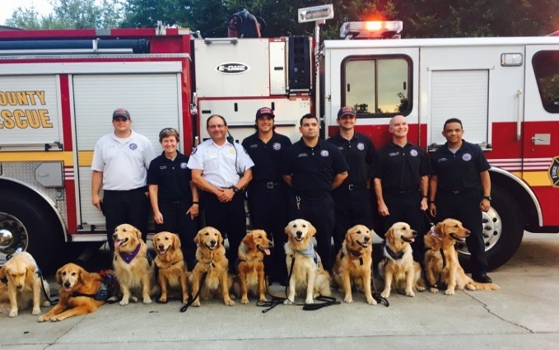
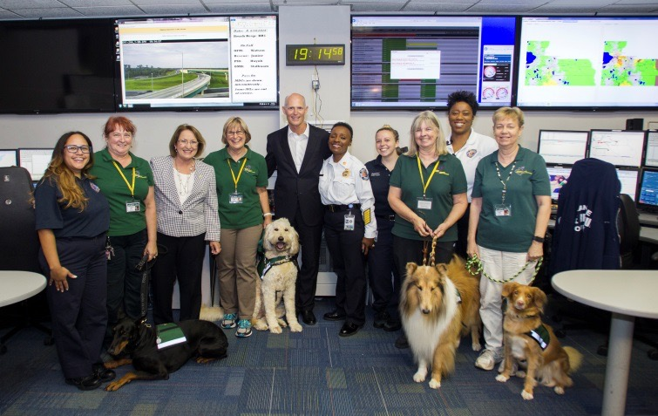
Caring for our Own
Employee Assistance Program
Activate Critical Incident Stress Management (CISM) Teams and Peer Support Teams
Reaching out to others in Fire Service
Comfort Dogs
Outreach from community members and local faith based organizations
Family Counseling
Survivors from Boston, New York
and Aurora showed support
University of Central Florida’s RESTORE Program

Slide 25
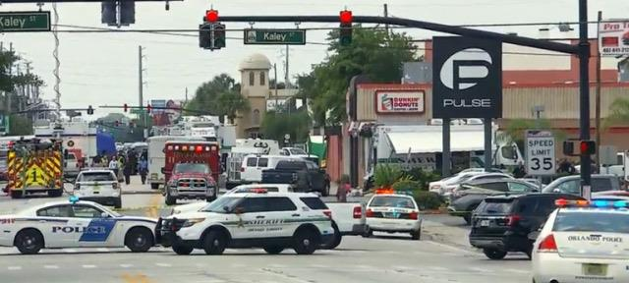
Local Business Implications and Assistance
  The scene and surrounding area streets were closed during the investigation.
45 businesses closed
(est. loss $500 - $150,000)
Small Business Administration (SBA) Interest Free Economic Injury Disaster Loans
City Main Street Program Coordination and Communication

Slide 26
What worked well?
Leadership Support
EOC serving as the central hub
Community Partnerships
  Value of existing relationships
Preparedness
  Engagement of non-traditional responders
Social Media/Website
IT Support in all locations
Notes:
Lessons learned:
More translators
Generic PIO email address
Overwhelmed with donations and offers to help – portal on website where people could say what they wanted to donate or offer, personnel to sort through the listing and match victims with goods/services available

Slide 27
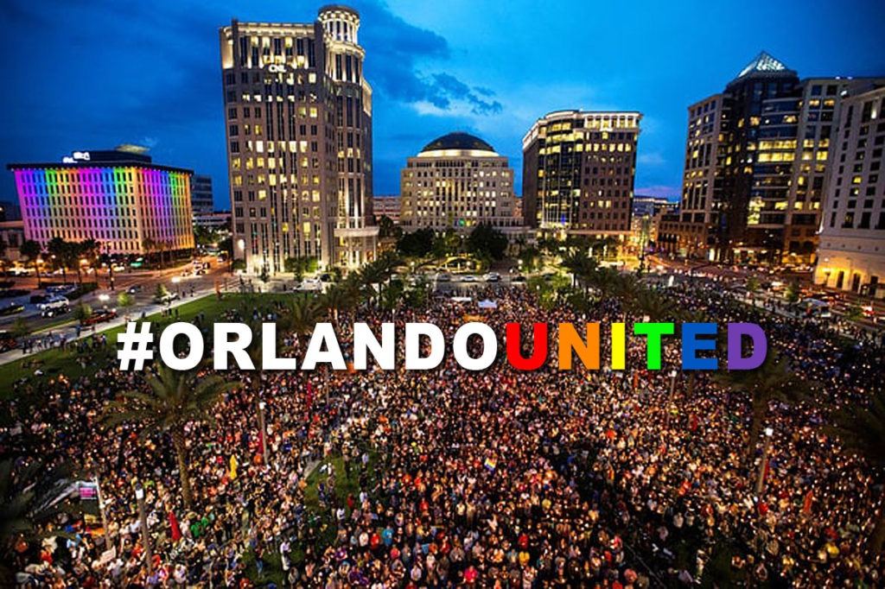

Slide 28

Thank You!
April Taylor
Deputy Emergency Manager
City of Orlando
april.taylor@cityoforlando.net
407-234-9061

